Slide 1
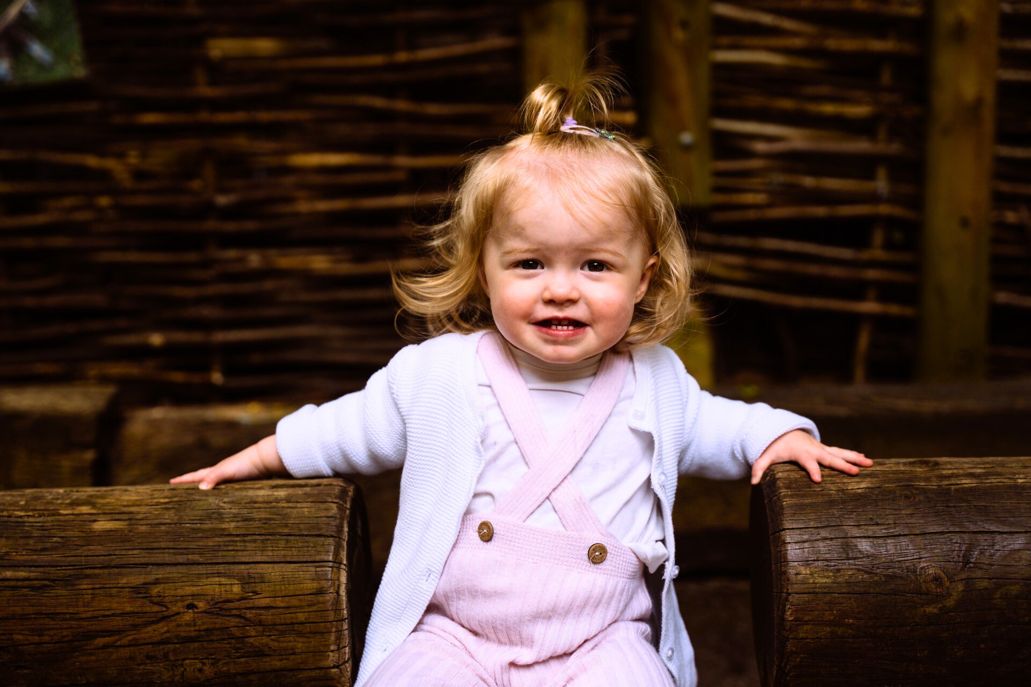
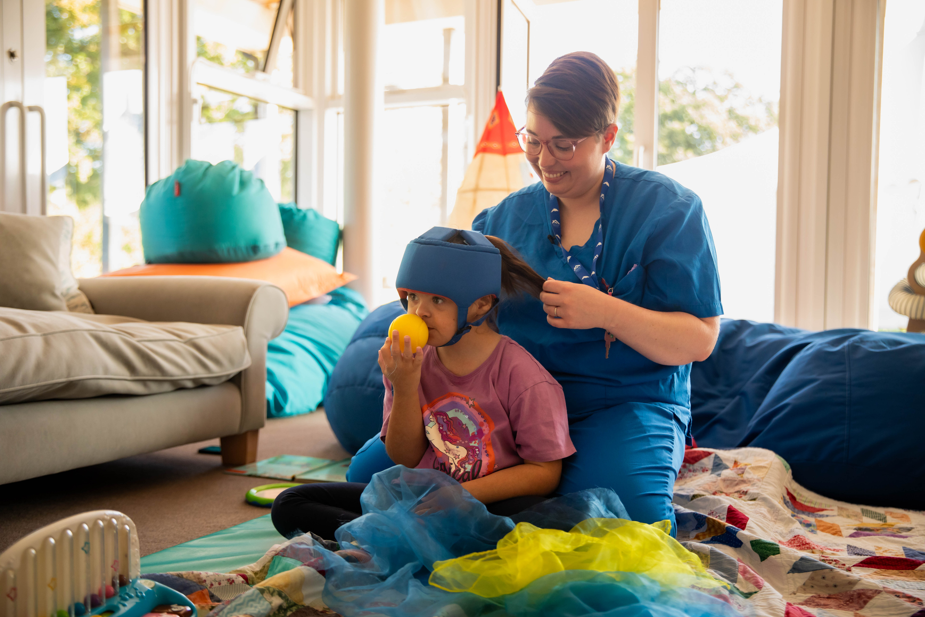

REACHING OUT TO EVERY CHILD AND FAMILY THAT NEEDS US.
Notes:
Thank you for inviting me to come and speak to you today.

Slide 2
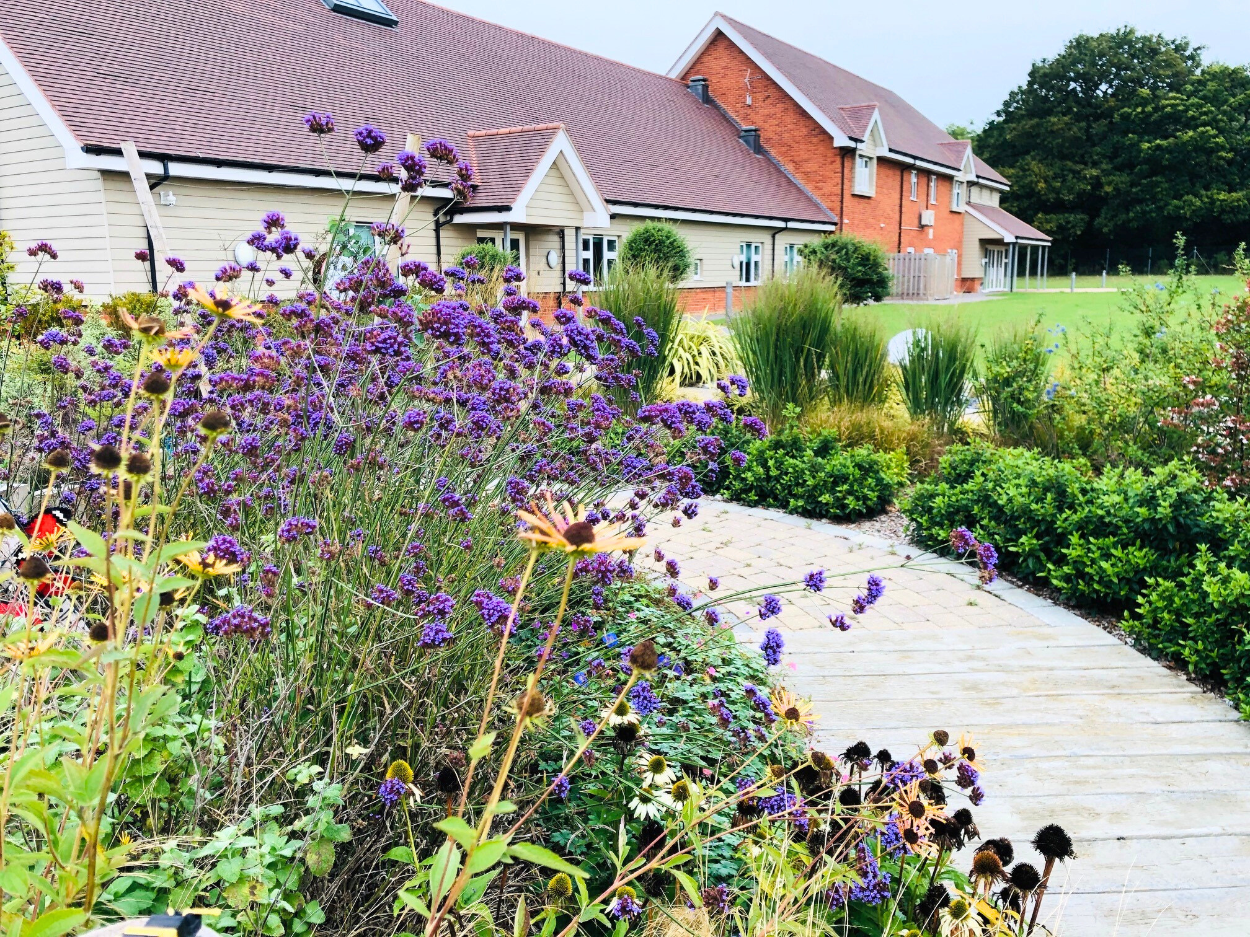
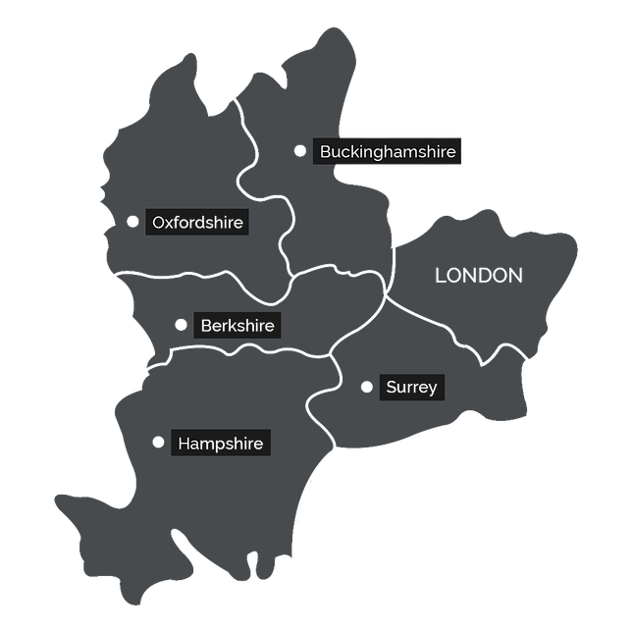


Our Vision
Providing a children’s hospice service within Berkshire, South Bucks and into surrounding counties, that will give children and families a choice of care and specialist support from a skilled and dedicated team.
Notes:
So what is Alexander Devine Children's hospice? We are the only children's hospice for Berkshire and some of the surrounding counties and we support children with life-limiting and life-threatening conditions and their families.
Our vision is to reach out to every child and family who needs us, no matter their situation and... currently we support more than 200 babies, children and young people, as well as more than 40 bereaved families with our specialist services. And with your support, we hope to continue to reach more families who need us.

Slide 3
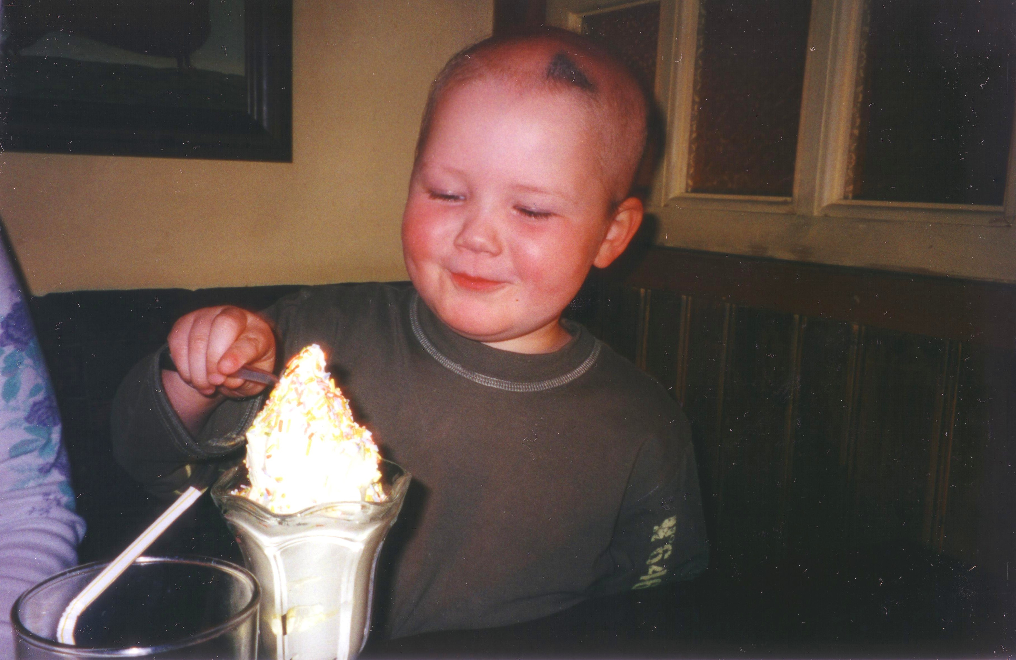
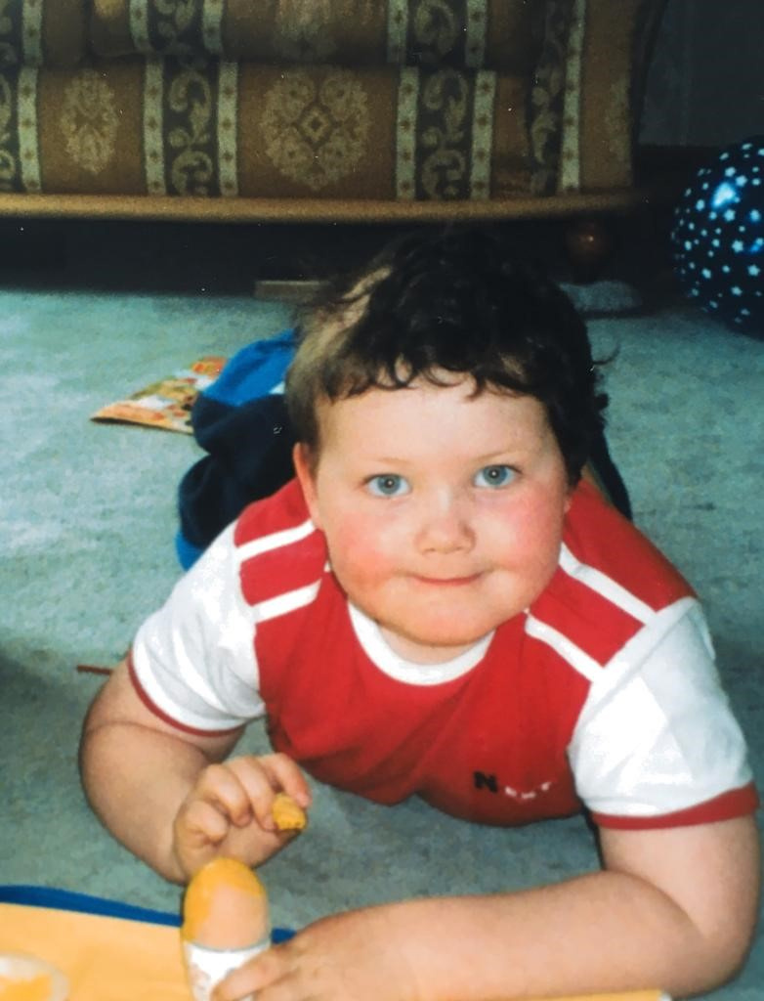
Meet Alexander, Our Inspiration
Notes:
The founding of the hospice is a story of an ordinary family who were blessed with an extraordinary little boy. The journey that was to change the lives of our Founder, Fiona Devine, began in November 2001 when her son was diagnosed with a brain tumour at just four years old.
Alexander was a very bright and funny child; he loved life and his family very much and had wisdom far beyond his years.
The grieving process started immediately and Fiona and her family's whole world was consumed by hospital appointments, doctors, nurses, operations, treatments, scans, stays in hospitals, etc.
Alexander endured four and a half years of operations, treatments and therapy and sadly died at the age of eight.
Through their experience and much research, it was clear that Berkshire needed its own children’s hospice. So they began the next chapter in their journey, the creation of Alexander Devine Children’s Hospice Service.

Slide 4

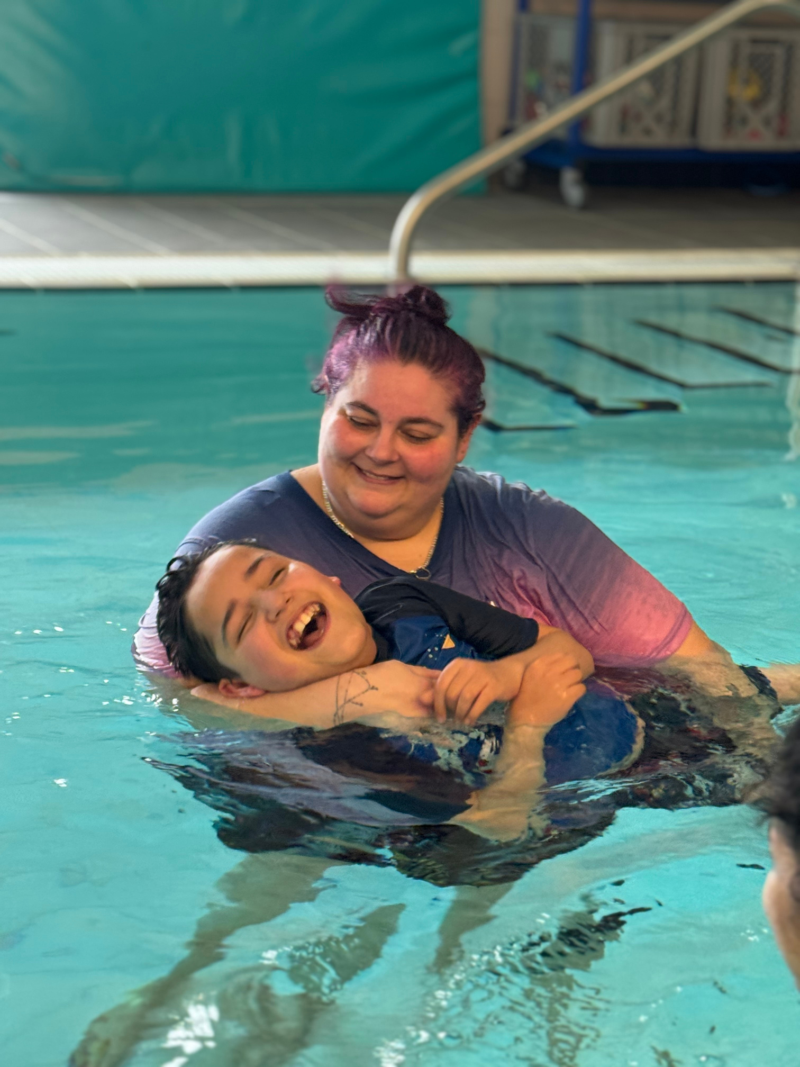
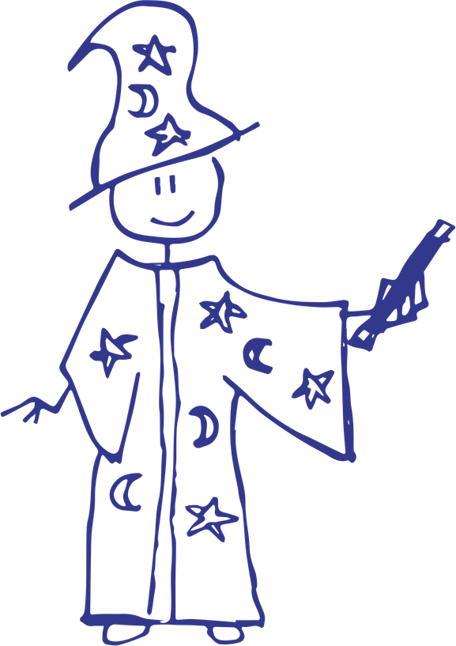




Our Services
Respite Care
Specialist Play
Symptom Management
Family Support
End of Life Care
Bereavement Support
Notes:
Alexander Devine Children's Hospice Service provides specialist care and vital support to children with life-limiting and life-threatening conditions and their families across Berkshire, South Bucks and into the surrounding counties.
We offer Respite Care, Specialist Play, Symptom Management, Family Support, End of Life Care and Bereavement Support.

Slide 5
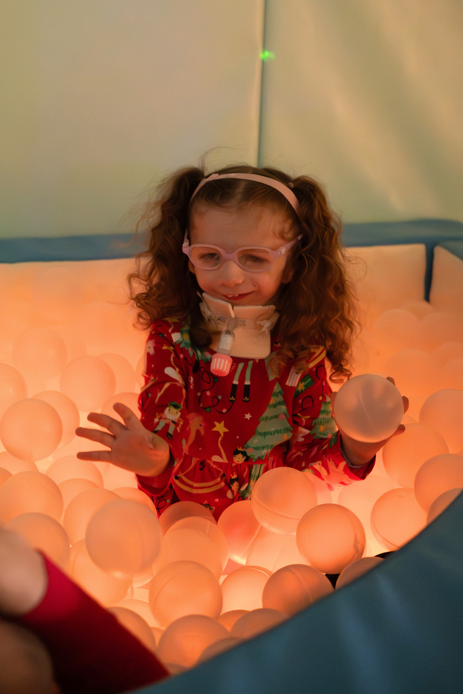
Meet Grace
Grace has Treacher-Collins Syndrome. At just four days old, she was fitted with a tracheostomy to open her windpipe and help her breathe. Now four years old, Grace requires 24/7 care to support her breathing and eating.
Parents of a child with a life-limiting and life-threatening condition, like Grace’s Mum, Georgina, don’t get any time to switch off.

Slide 6
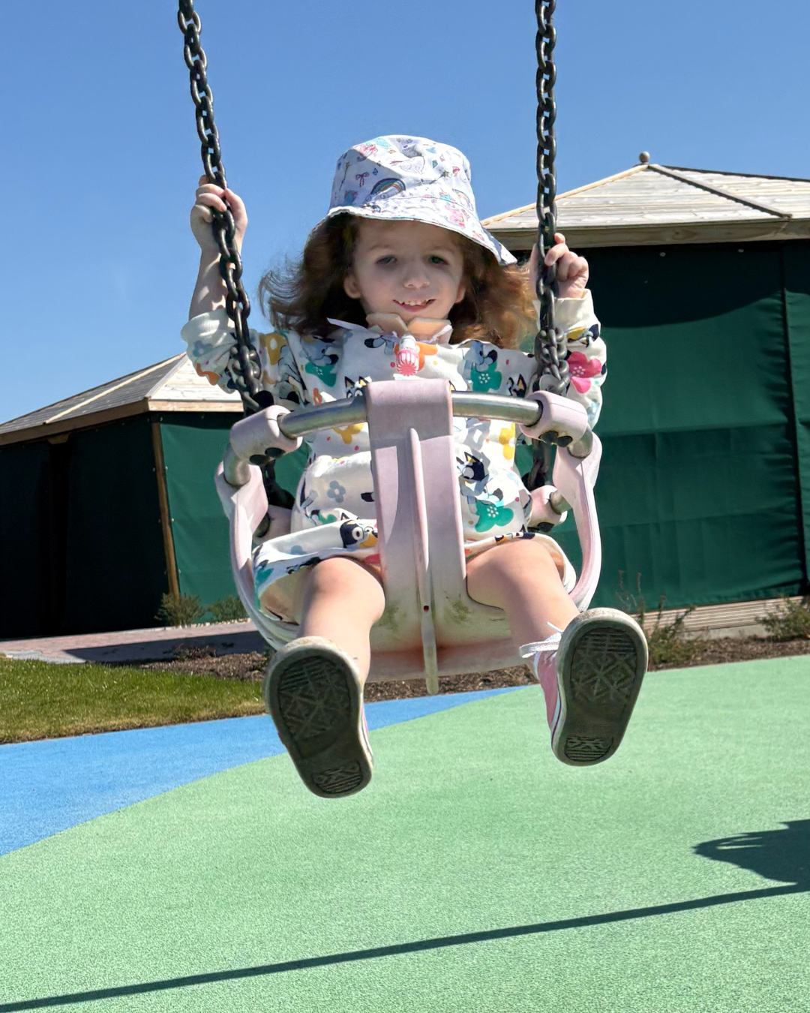
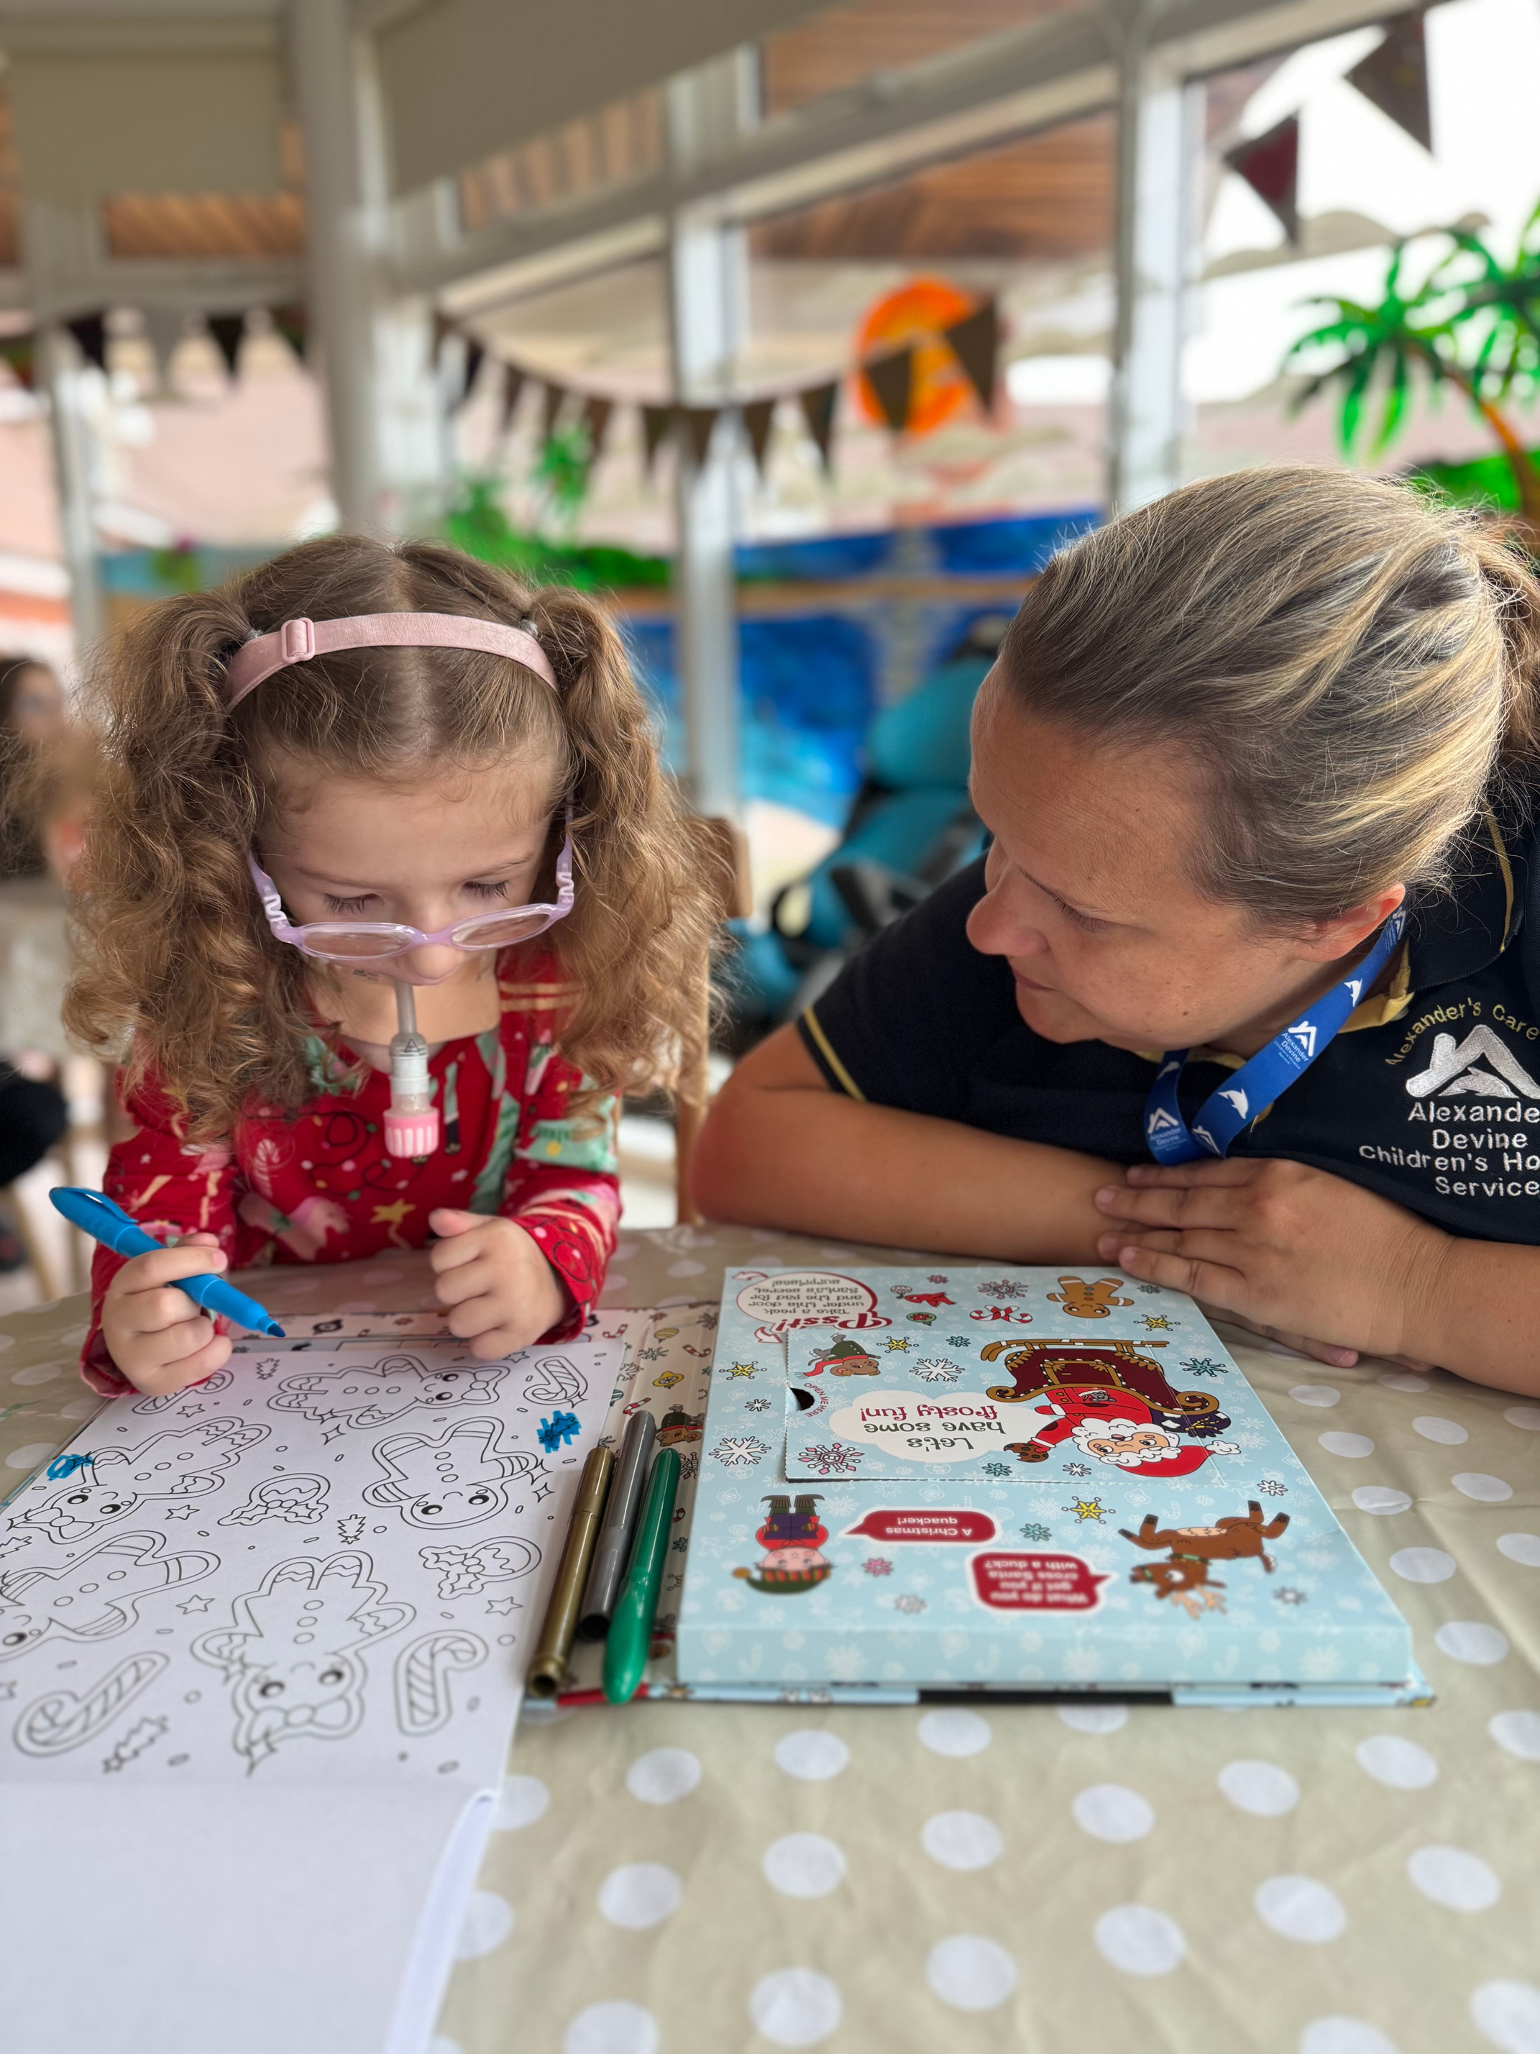
Respite Care
Notes:
We understand that when a child has complex healthcare needs and requires round-the-clock care, the emotional and physical pressures on families can be immense. Taking a break from caring is not always possible.
Respite care provides families with the opportunity to do the things that you might not normally have the chance to do. Whether families choose for respite to be in their own home or in our hospice, they will have peace of mind that their child is being looked after by a caring team that they know and trust as well as having plenty of fun.
This could be time in the hydrotherapy pool, making a mess in our creative learning zone, baking or relaxing in the sensory room.
Grace's favourites include riding in our electric child cars, playing in the specialist outdoor playground, and dressing up in the many costumes we have.

Slide 7
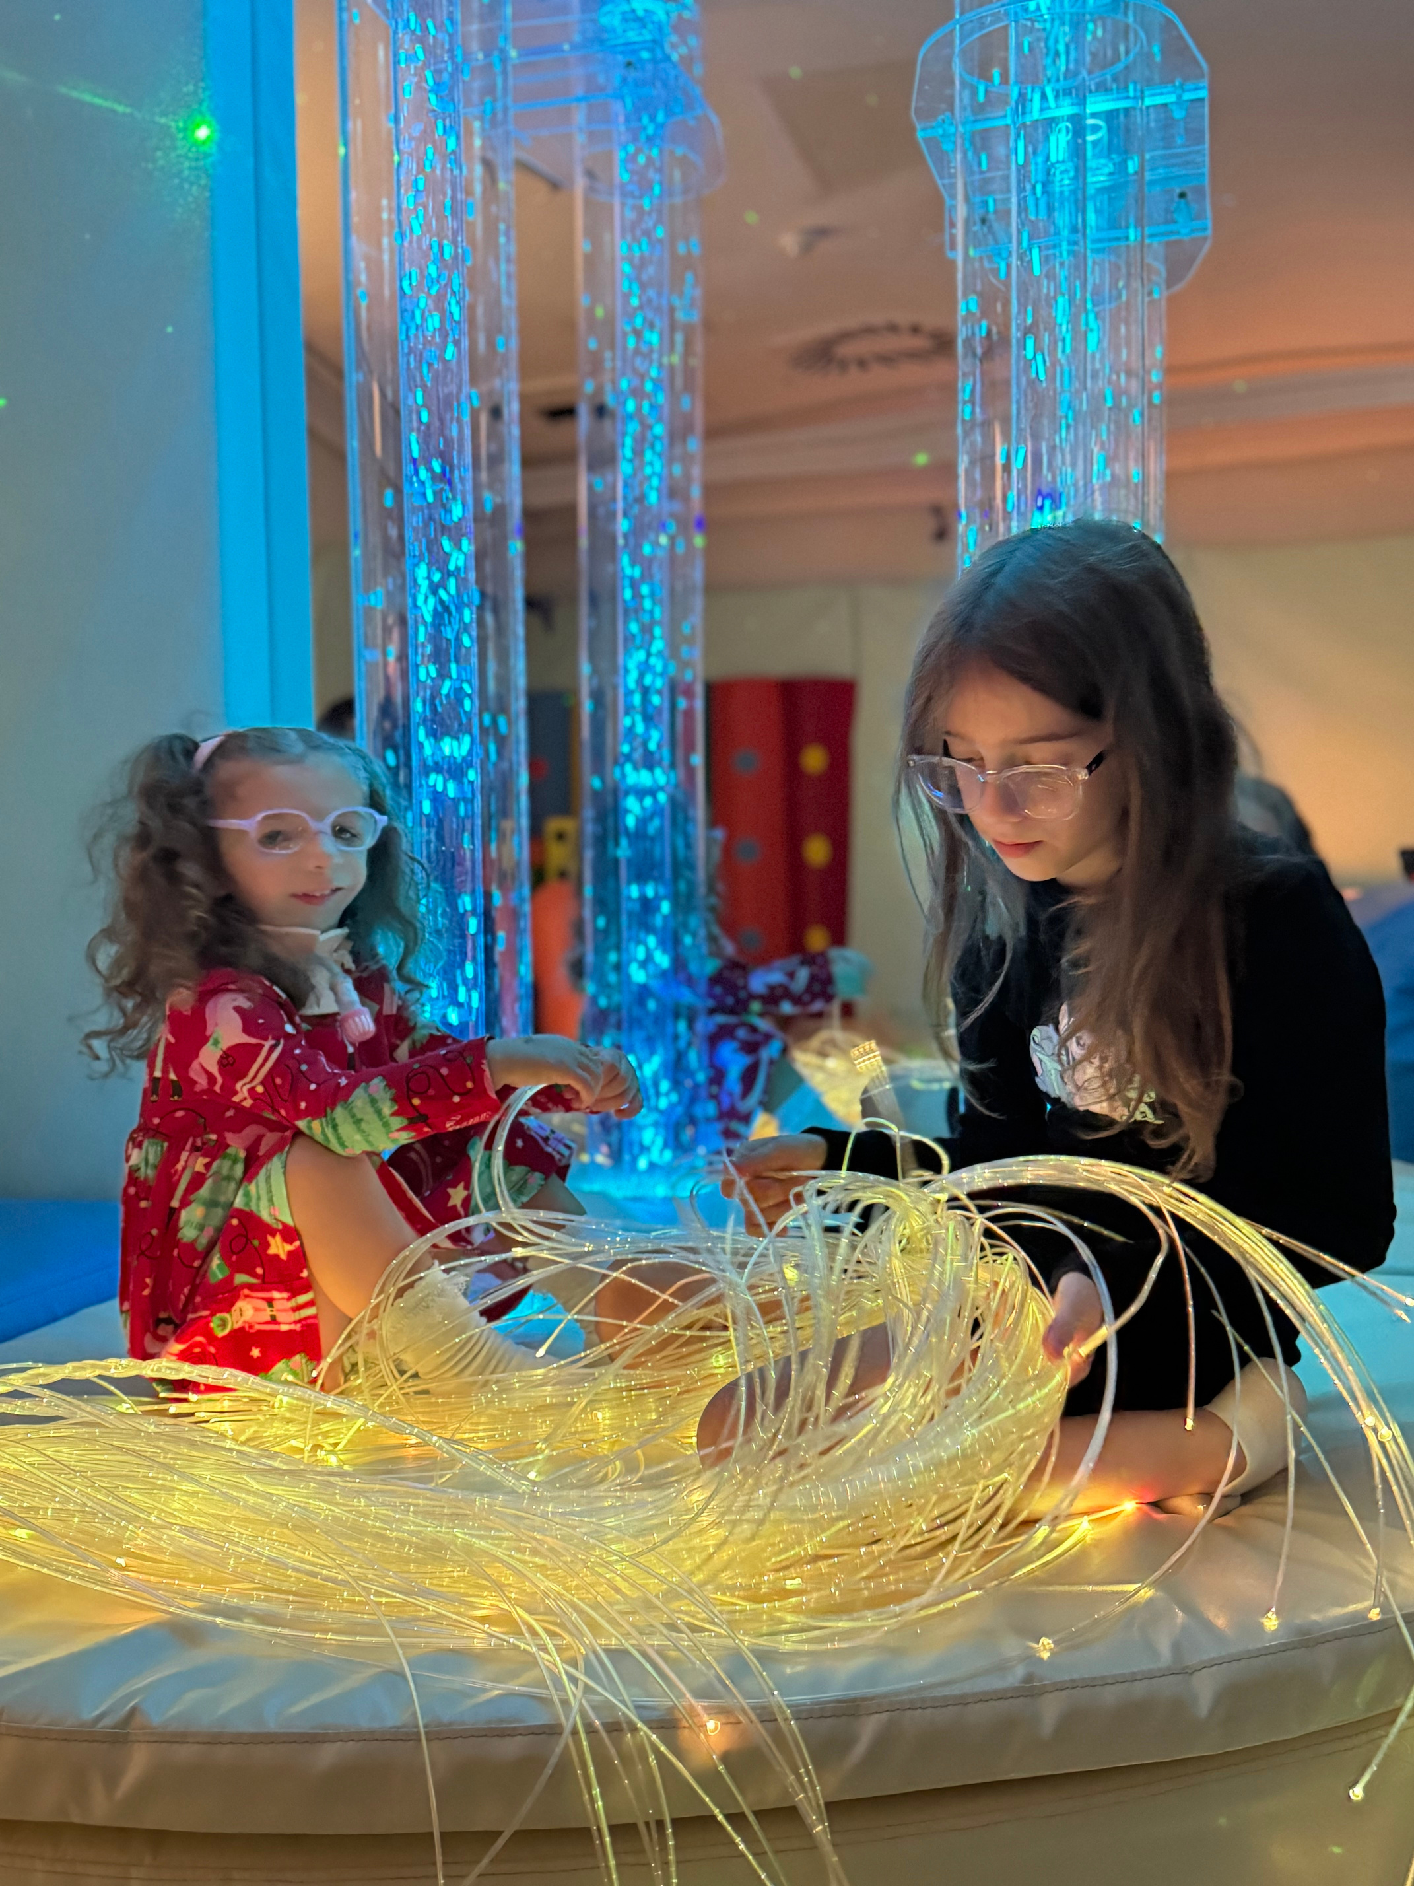
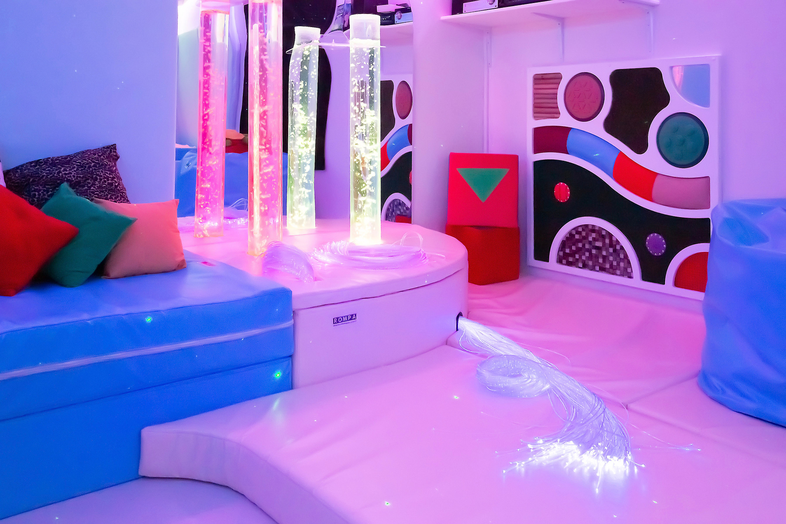
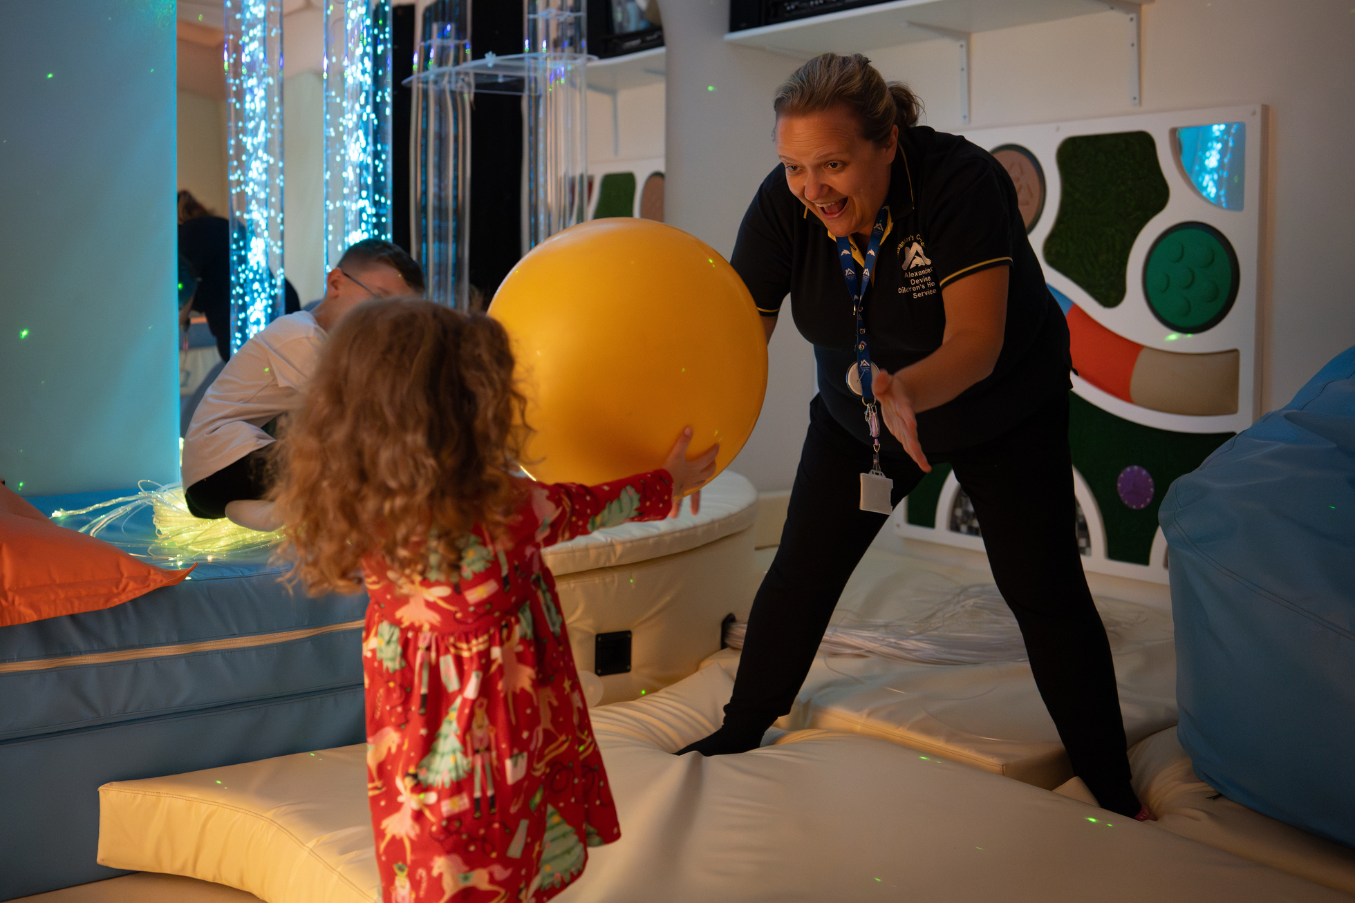
Specialist Play
Notes:
Alexander’s Care Team works with the children and young people we support providing age appropriate activities to stimulate, engage and build relationships. This can take place in the home, in the hospice, in schools or in the wider community.
Our play specialists can also provide activities to help with coping, feelings and other challenges that the children and young people, as well as their siblings may experience.
Grace loves spending time in our Sensory Room, enjoying the lights and ball pit, all within a safe and engaging environment.

Slide 8
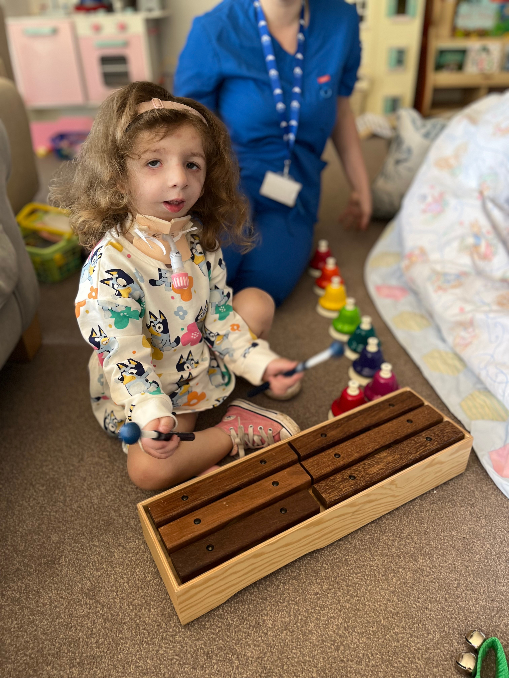
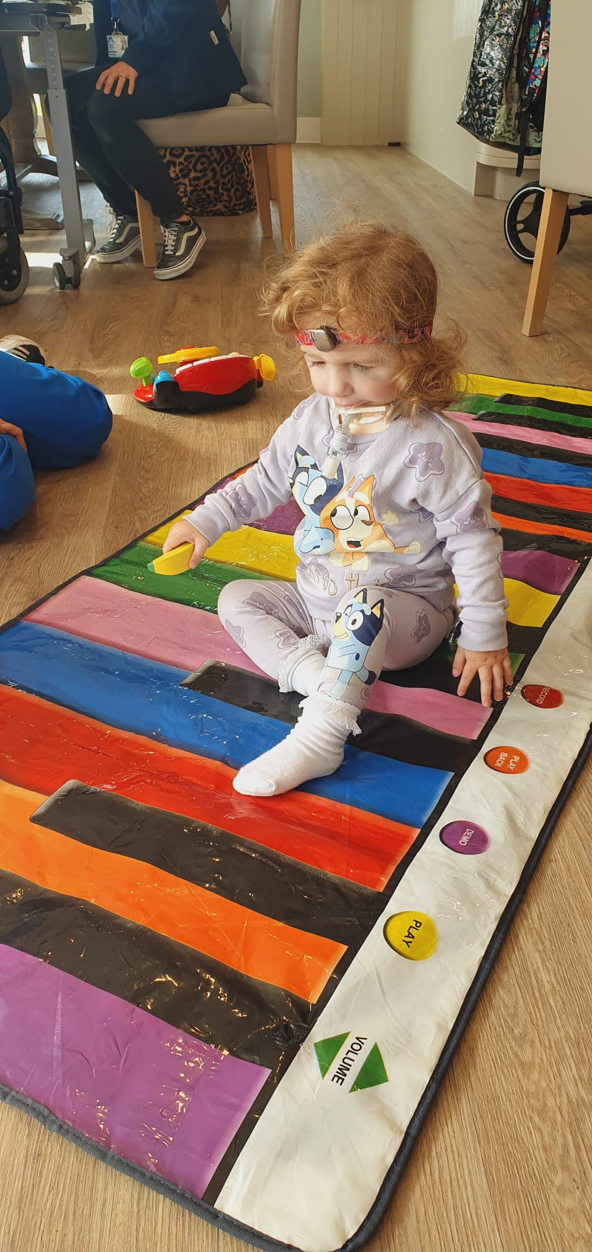
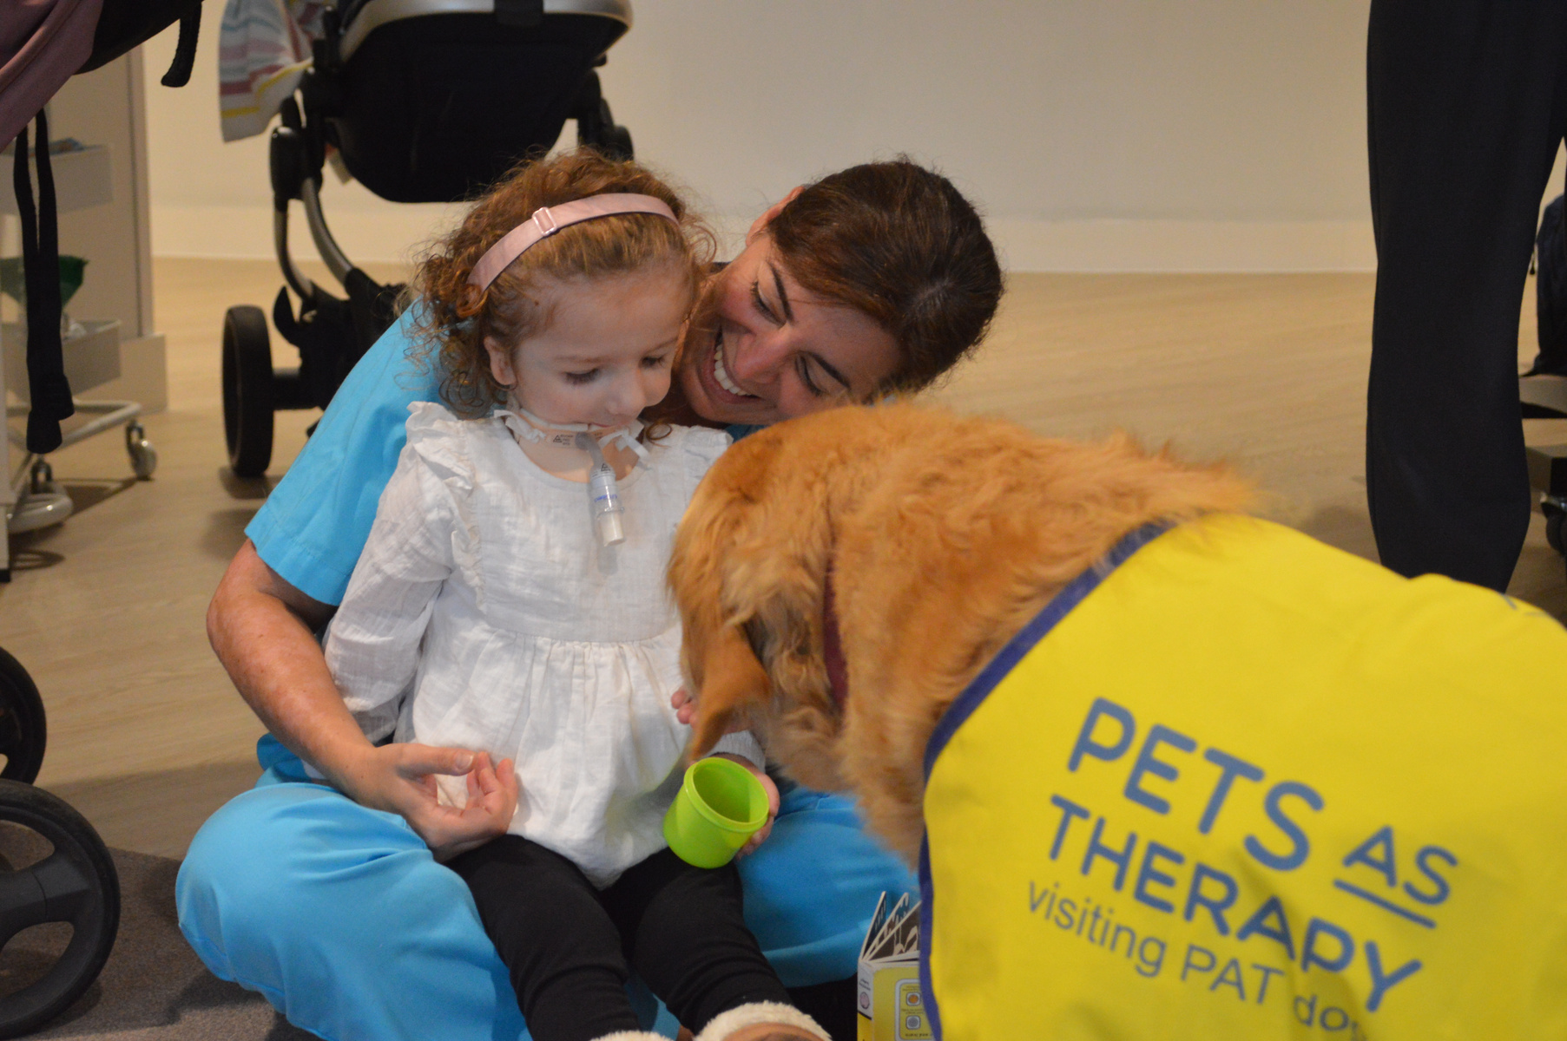
Music and Pet Therapy
Notes:
Music therapy offers the children a place to express themselves in their own way. Some children have busy lives with siblings or complex care routines and a quiet space just for them may be a welcome experience.
We also receive regular visits from Pets as Therapy, where Evie, a beautiful golden lab, visits the children, just like you can see Grace doing here.

Slide 9
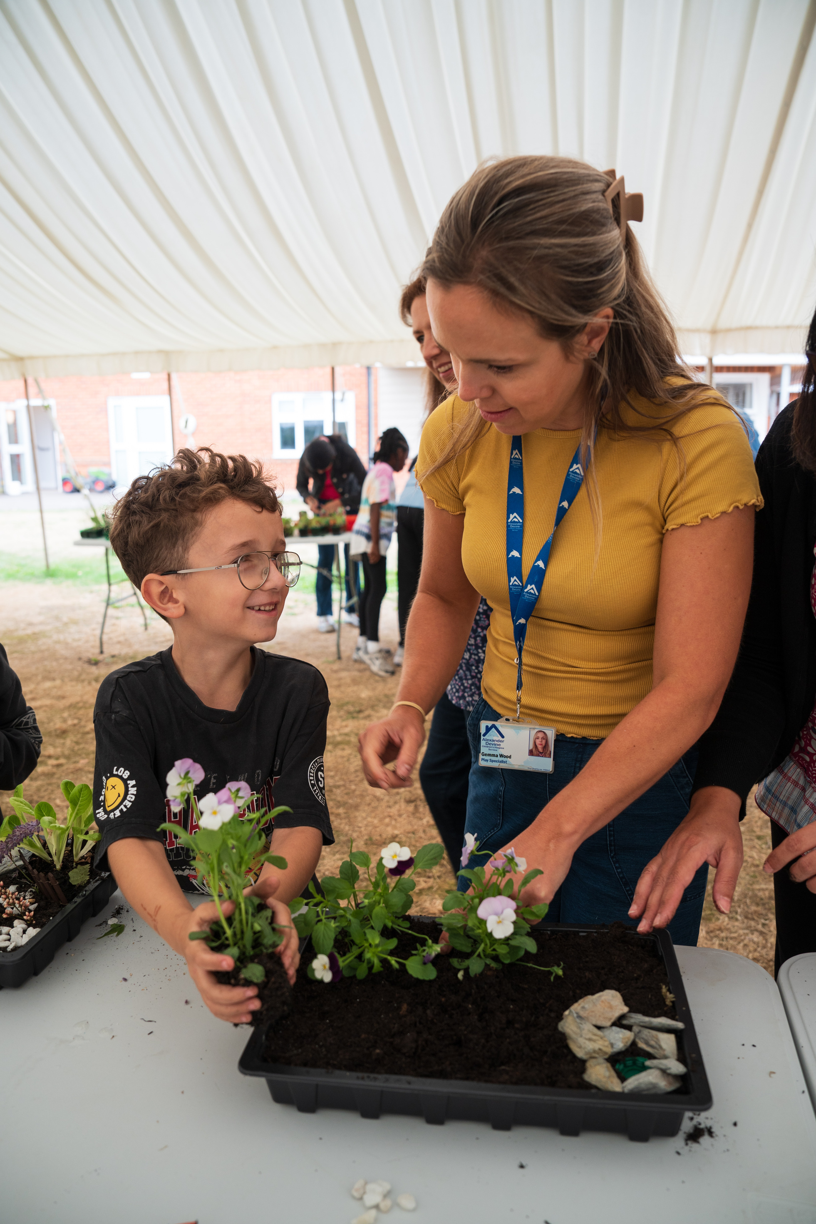
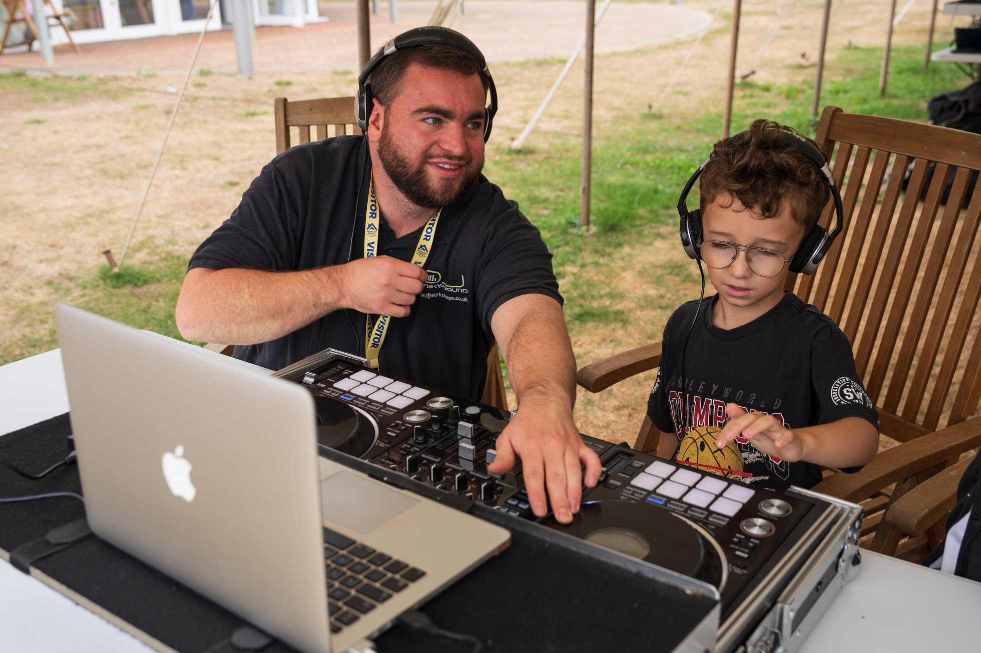
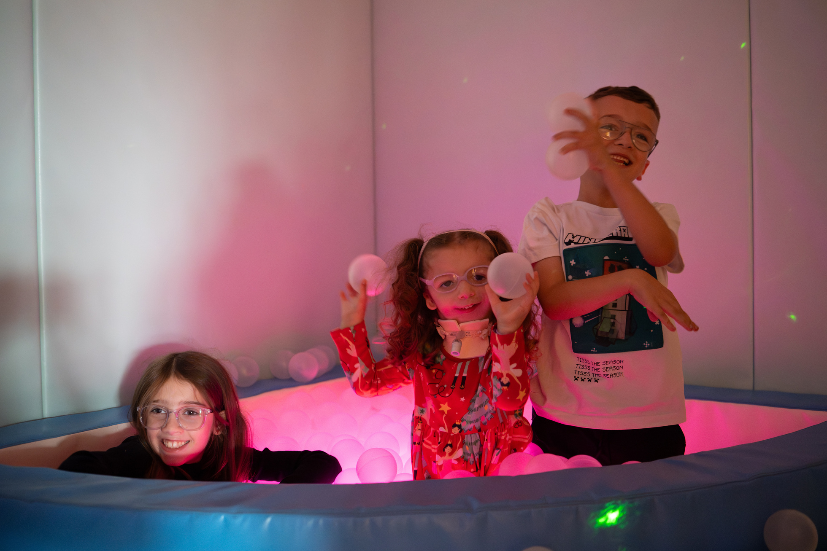
Sibling Support and Activity Days
Notes:
Meet Zac and Caitlyn, Grace's two siblings. They are both supported regularly by our Play Specialist teams.
Our play specialists work closely with our supported siblings, providing activities to help with coping, feelings and other challenges that they may experience.
In addition, they run group activity days and sibling outings to encourage friendship and peer support.

Slide 10
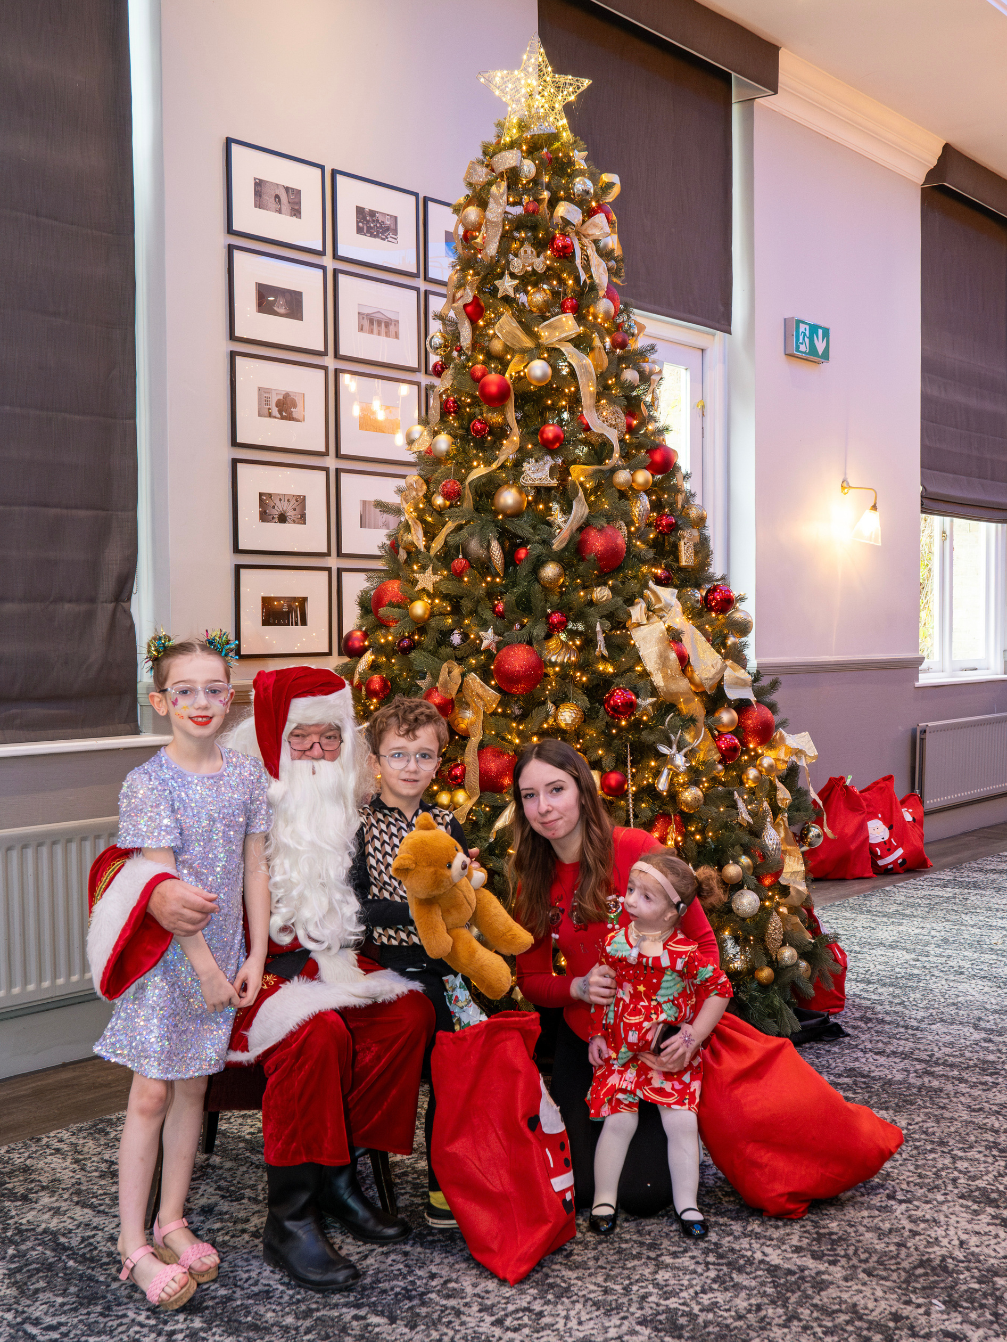
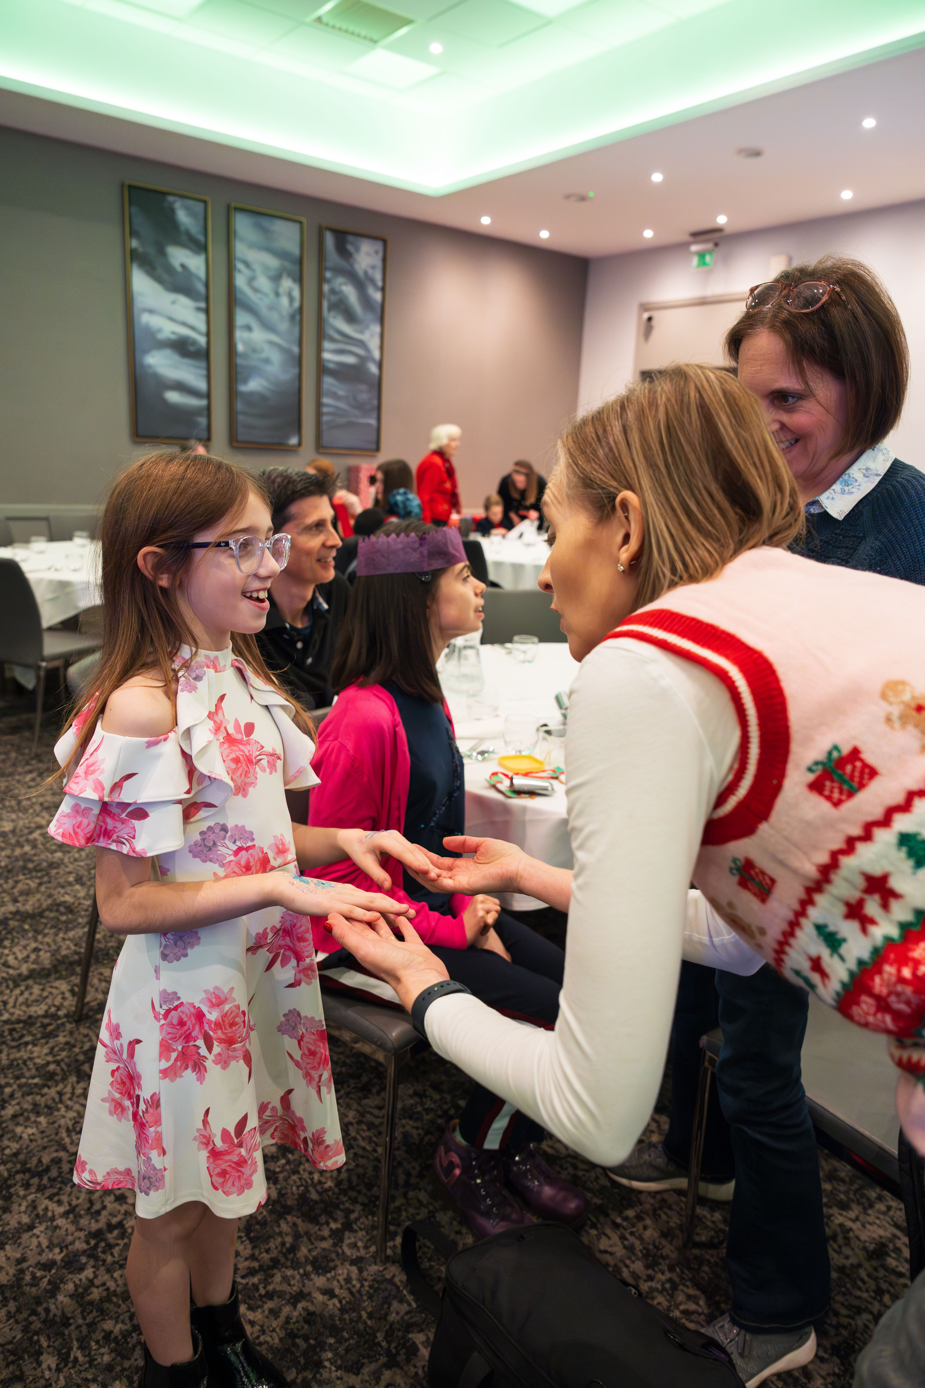
Accessible Family Experiences
Notes:
Families just like Grace's love attending our accessible family experiences. From our annual Christmas Party, to our Santa's Grotto, the Spring Family Fun Day and much more.
These events provide our families with the chance to do things safely as a family that they couldn’t usually do in public settings, like the splash sessions in the hydrotherapy pool. It's provides the element of inclusion, where no child is left out.

Slide 11
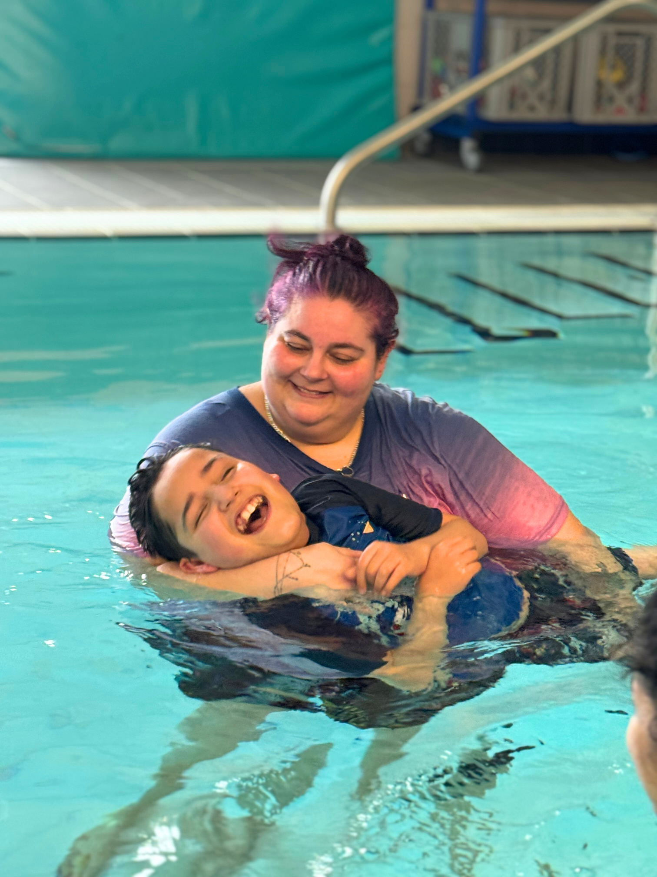
Meet Riley, Stanley and Shailza
Riley was born with a rare chromosomal genetic condition that shapes every aspect of his life. He has extremely limited mobility, relies on a wheelchair, is tube fed, and non-verbal.
But the hospice is more than activities and respite. It has also become a place of remembrance and care. In 2022, Riley’s brother, Stanley, died from the same condition. Through it all, the hospice has continued to support the family, including their mum, Shailza.

Slide 12
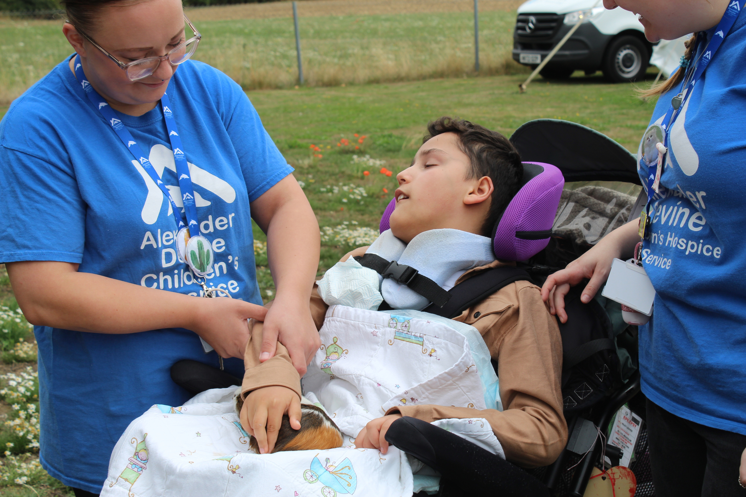
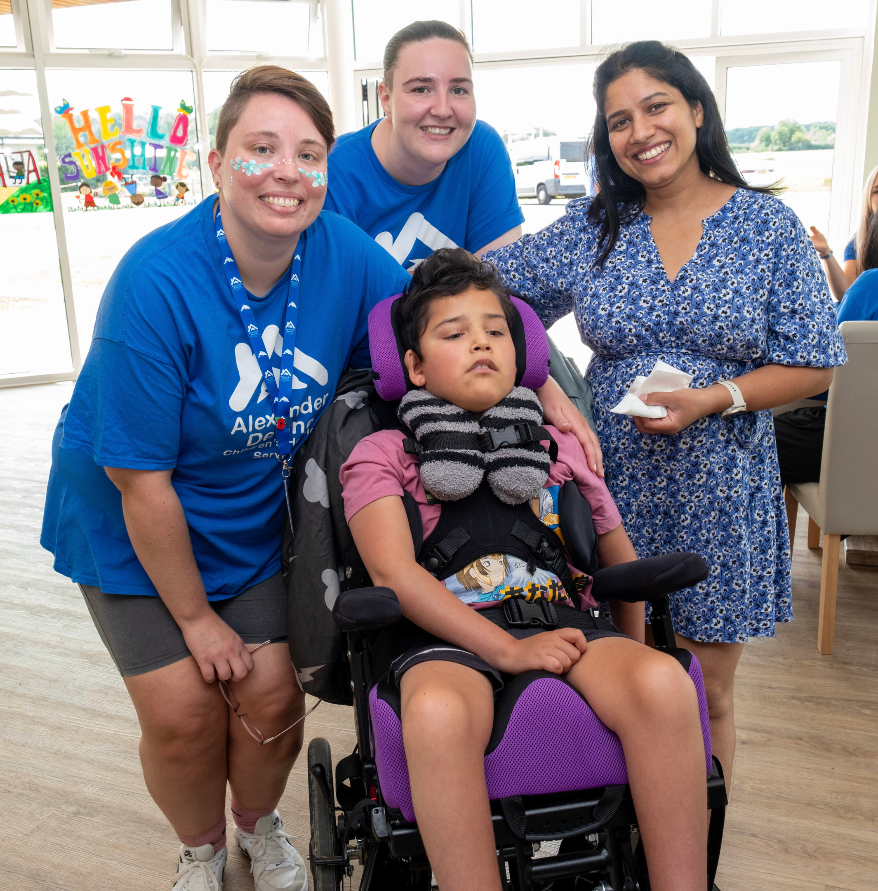
Respite Care
Notes:
We understand that when a child has complex healthcare needs and requires round-the-clock care, the emotional and physical pressures on families can be immense. Taking a break from caring is not always possible.
Respite care provides families with the opportunity to do the things that you might not normally have the chance to do. Whether families choose for respite to be in their own home or in our hospice, they will have peace of mind that their child is being looked after by a caring team that they know and trust as well as having plenty of fun.
“As soon as we arrive at the gates, Riley starts giggling to himself with enjoyment,” she says. “He knows exactly where he is.”

Slide 13
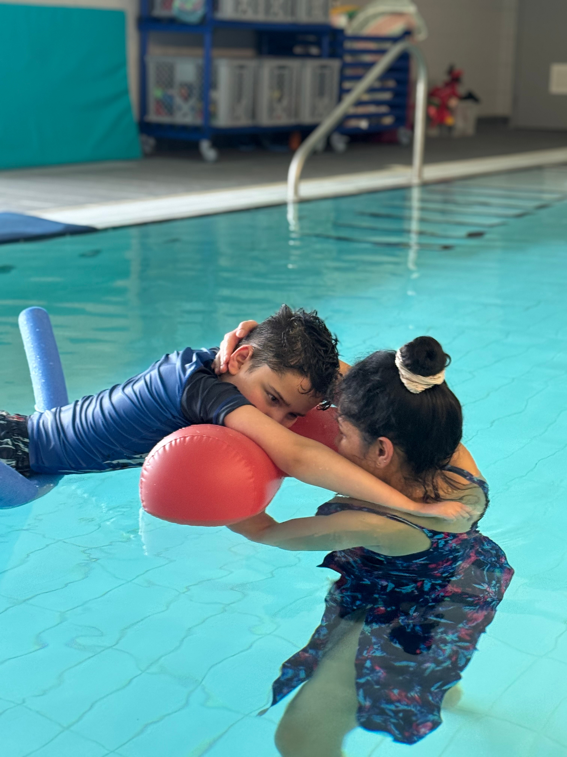

Physiotherapy and Hydrotherapy
Notes:
Support Riley with his mobility, which is very limited on land. The warm water and hygienic environment provides him with a safe space to access a fun and relaxing activity, as well as benefiting from the physiotherapeutic element of his sessions.

Slide 14
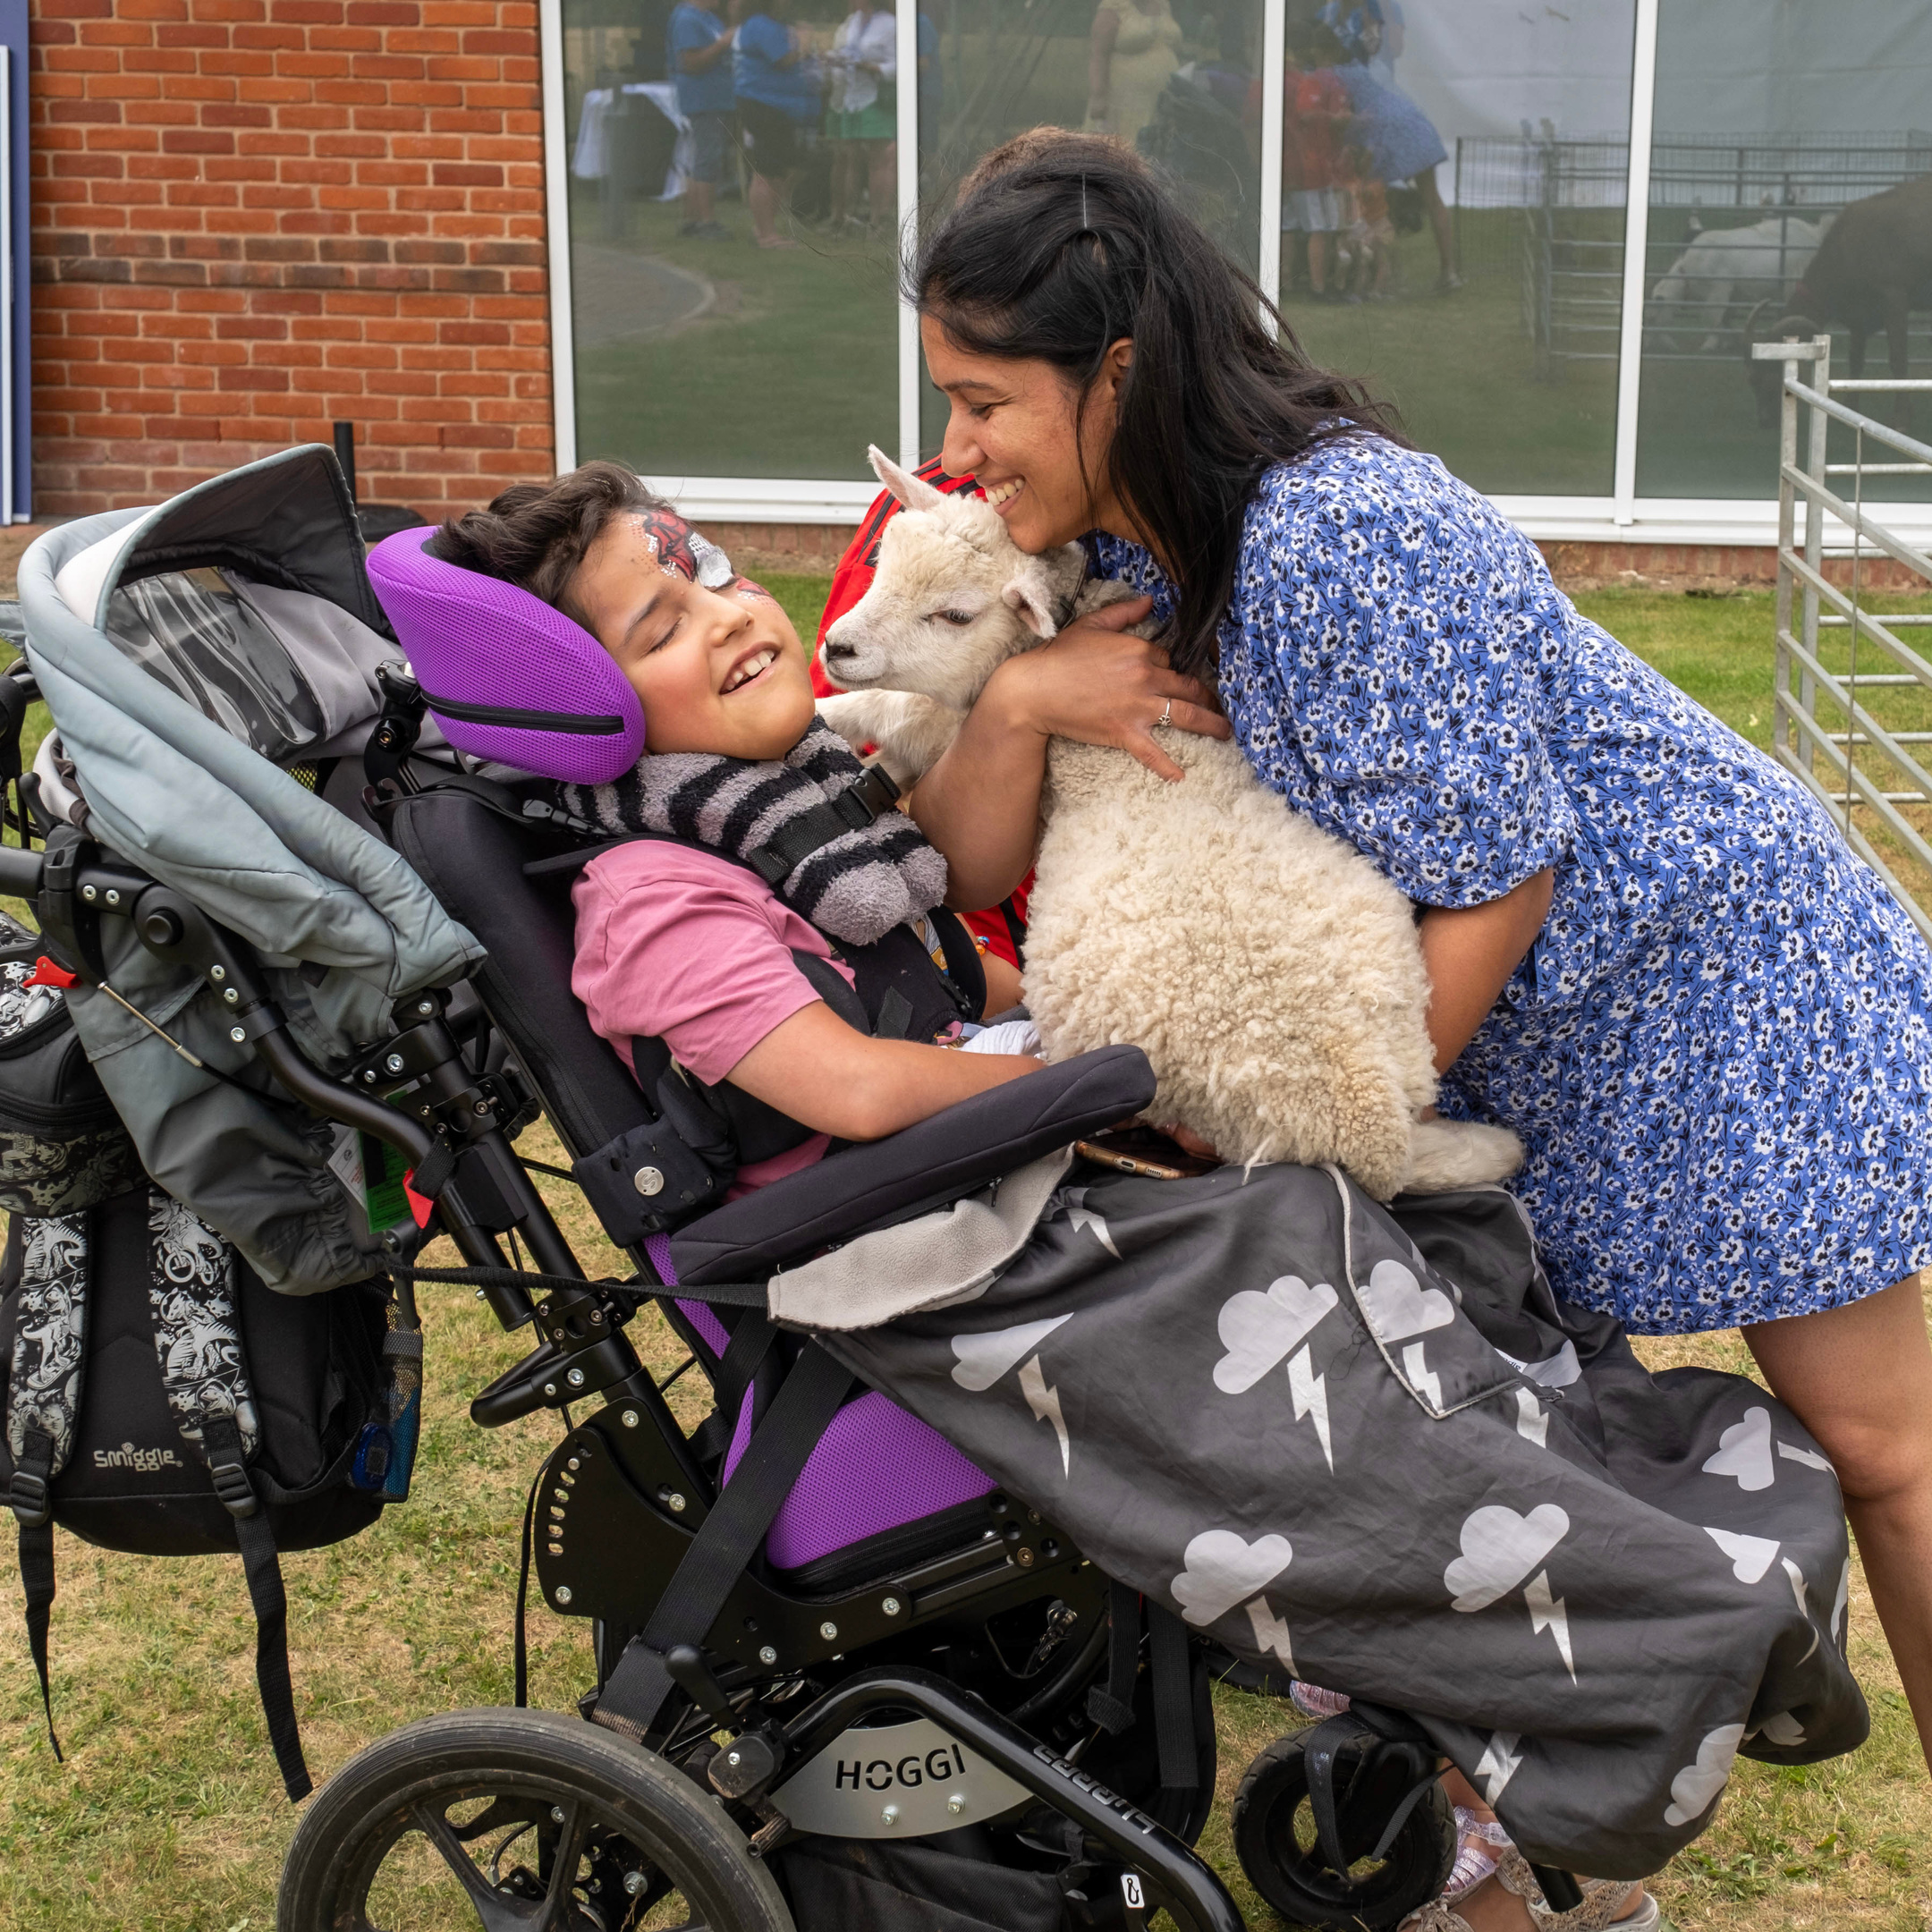
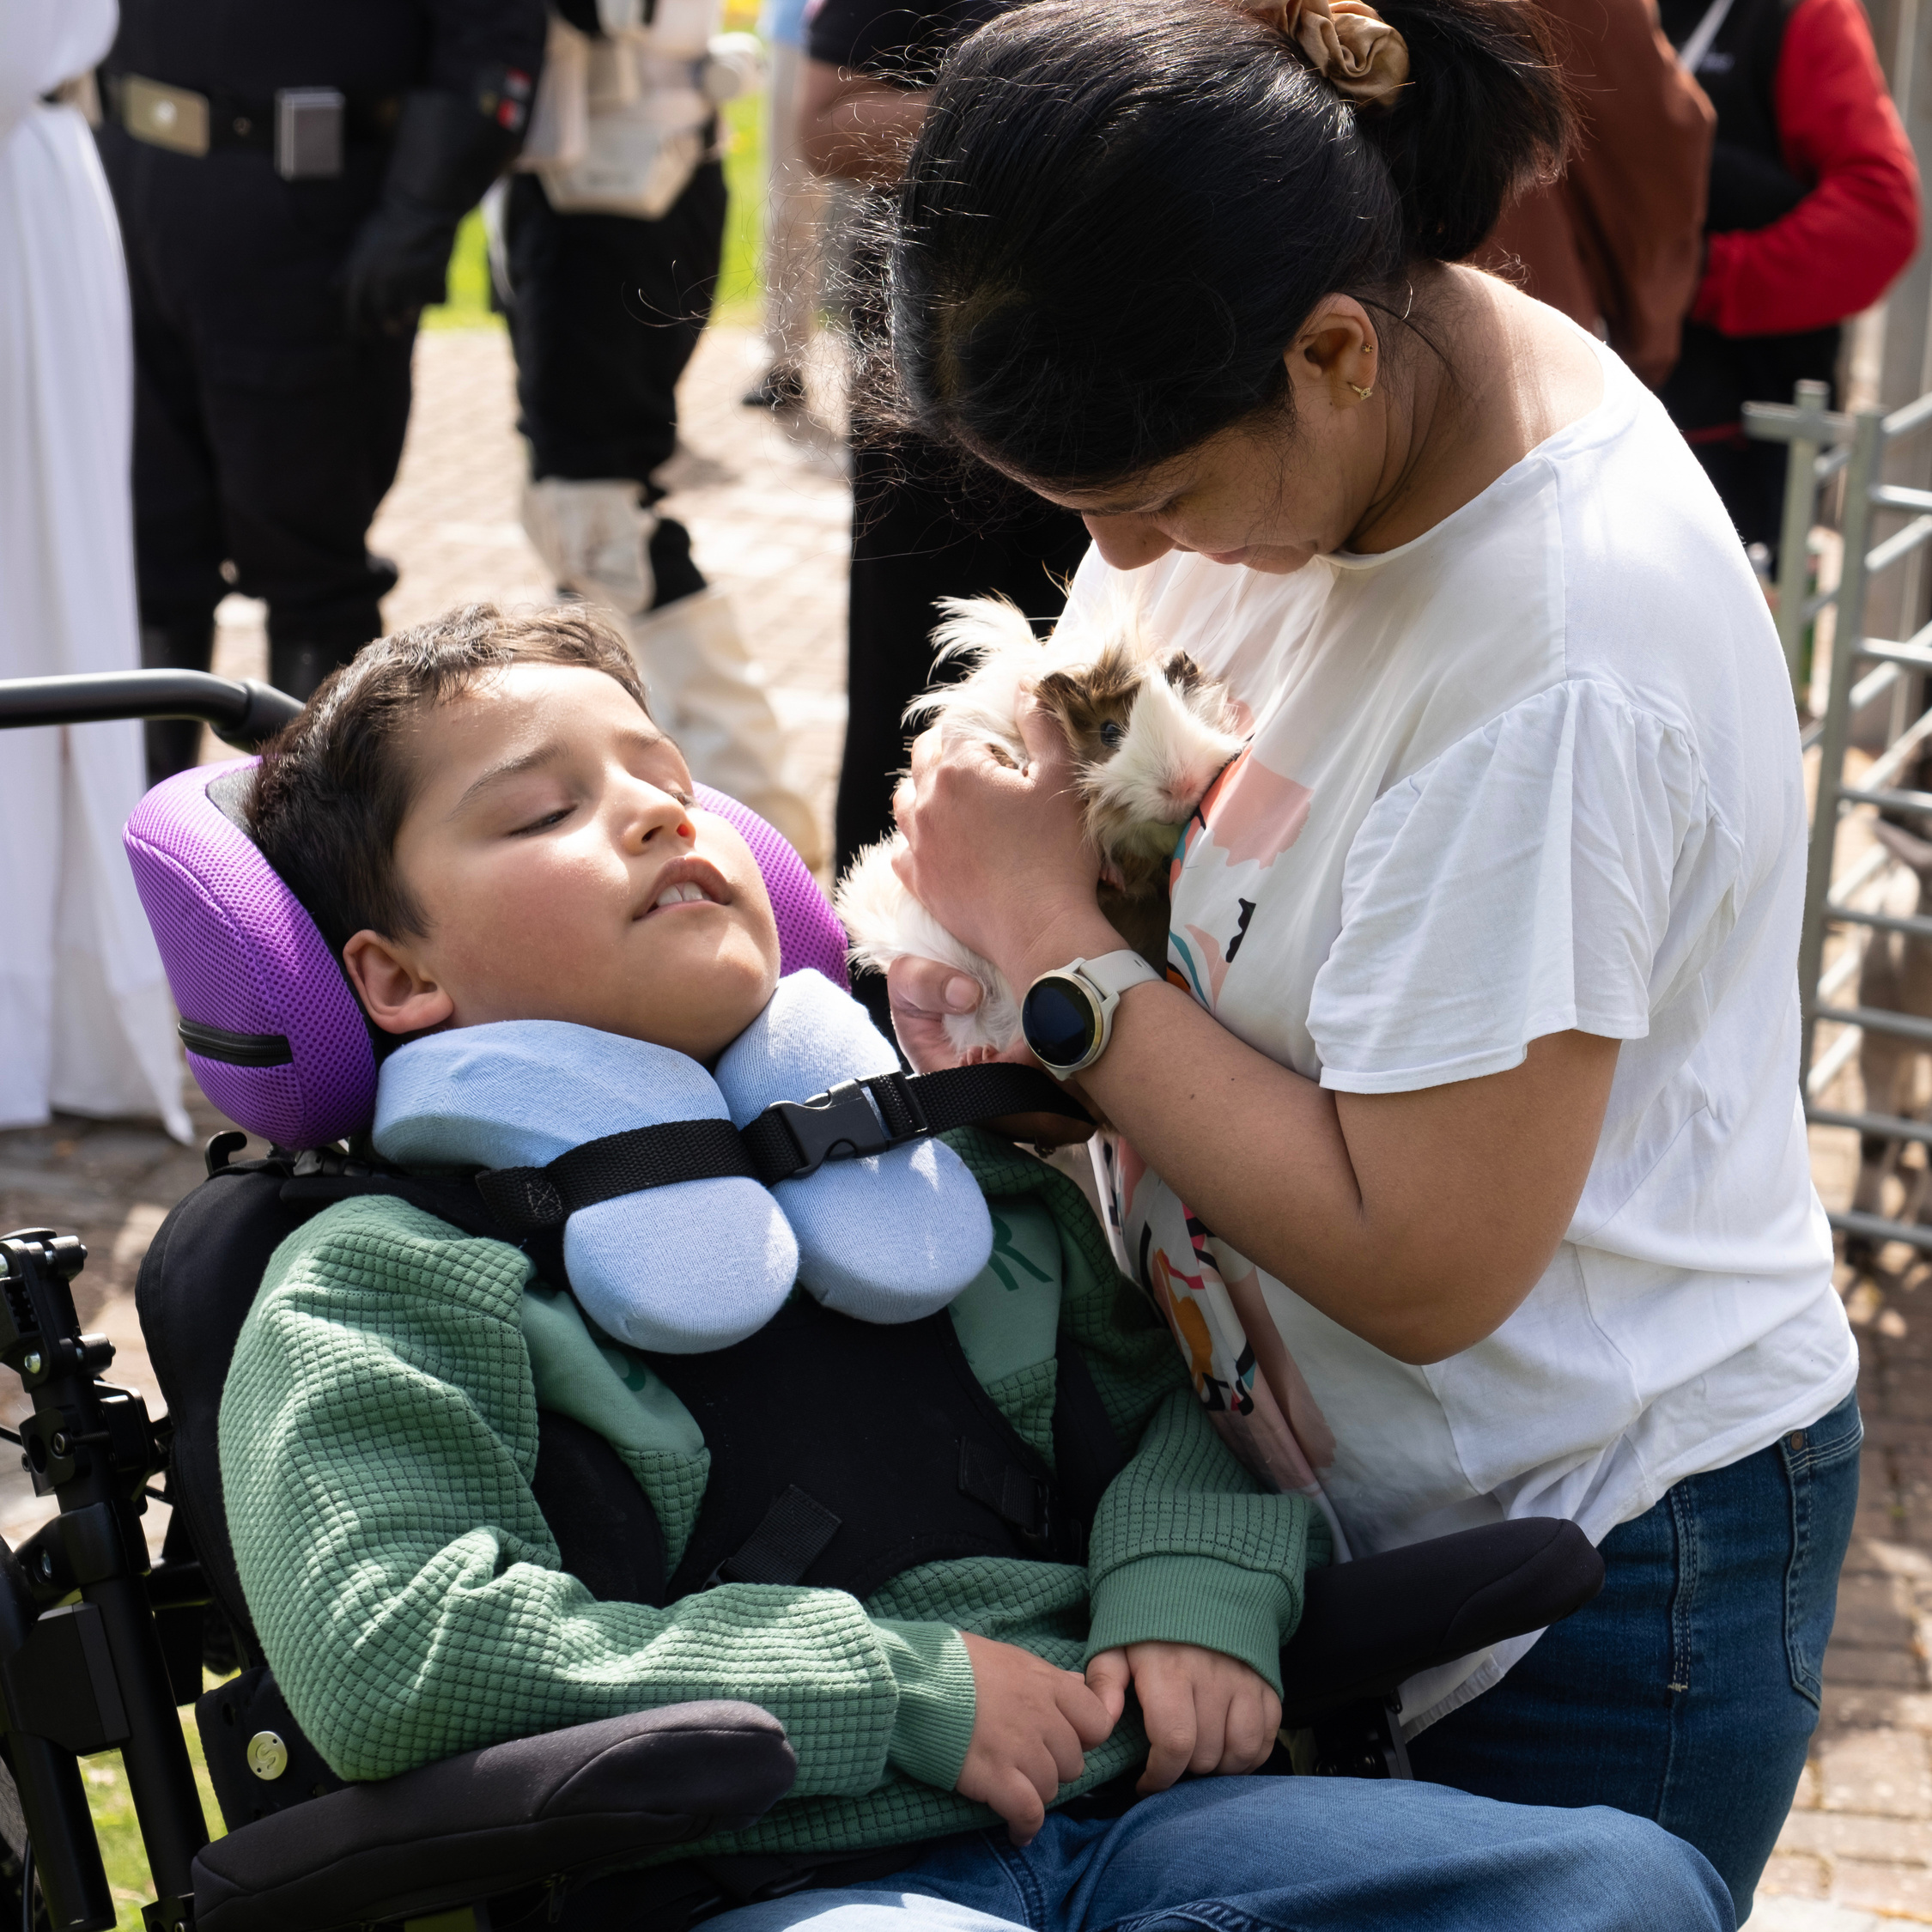
Family Fun Days
Notes:
Now Riley is nearly 13 and dependent on constant medical equipment, taking him out into the wider world can be challenging. Events that many families take for granted require careful planning and carry real risks. But at the hospice, everything changes.
Riley’s mum, Shailza says “The Family Fun Days are incredible. It’s an opportunity for Riley to enjoy these celebrations in a safe environment, just like any other child would. The hospice brings all the fun into one place. And for me, it’s also a chance to meet other families who just understand.”
There’s something magical about the Spring, Summer and Christmas Fun Days. The laughter, the activities, and the shared understanding between parents who don’t need to explain the complexities of their lives.

Slide 15
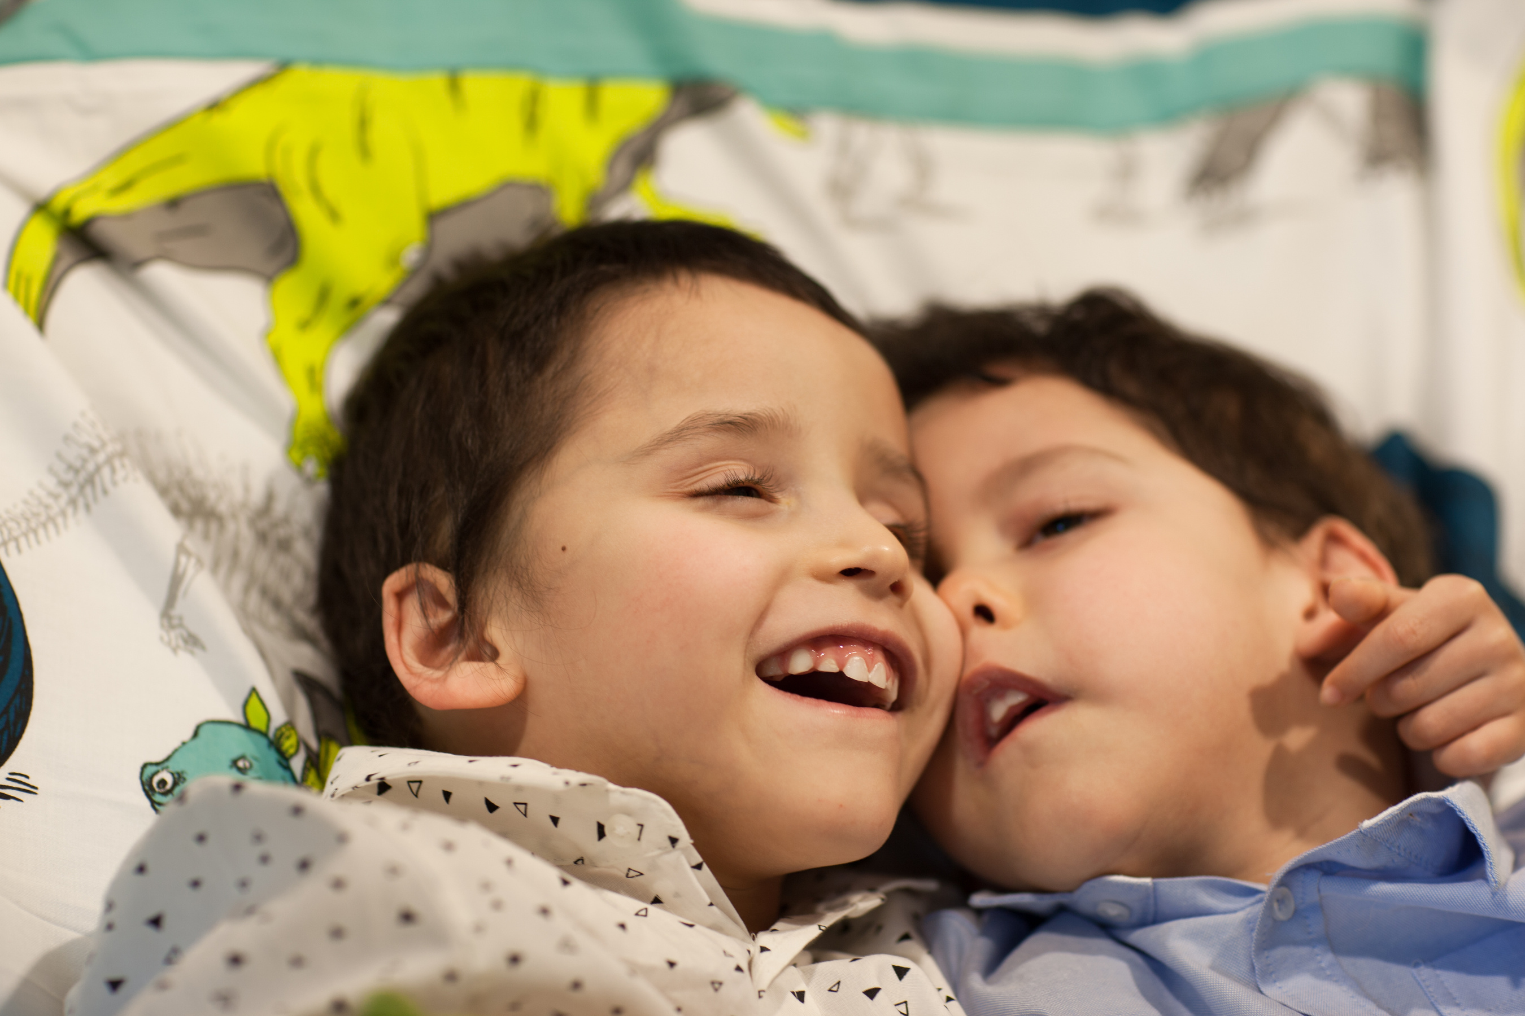
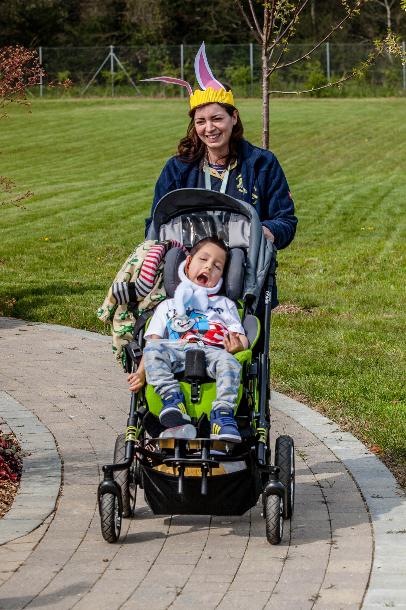
End of Life and Bereavement Support
Notes:
In 2022, Riley’s brother Stanley died from the same condition. Whilst Stanley spent the end of his life at a different organization, Alexander Devine continued to provide emotional support as well as support with his end of life care plan. We can support families through the end of their child’s life in our hospice building, at home, or in the community in hospitals or other organisations. Following their bereavement, we have continued to support his family with counselling.
We can provide counselling for parents and age appropriate support for siblings. Our work incorporates memory work to help with grief and commemorating the child. We also hold remembrance events for families to remember their loved ones.

Slide 16
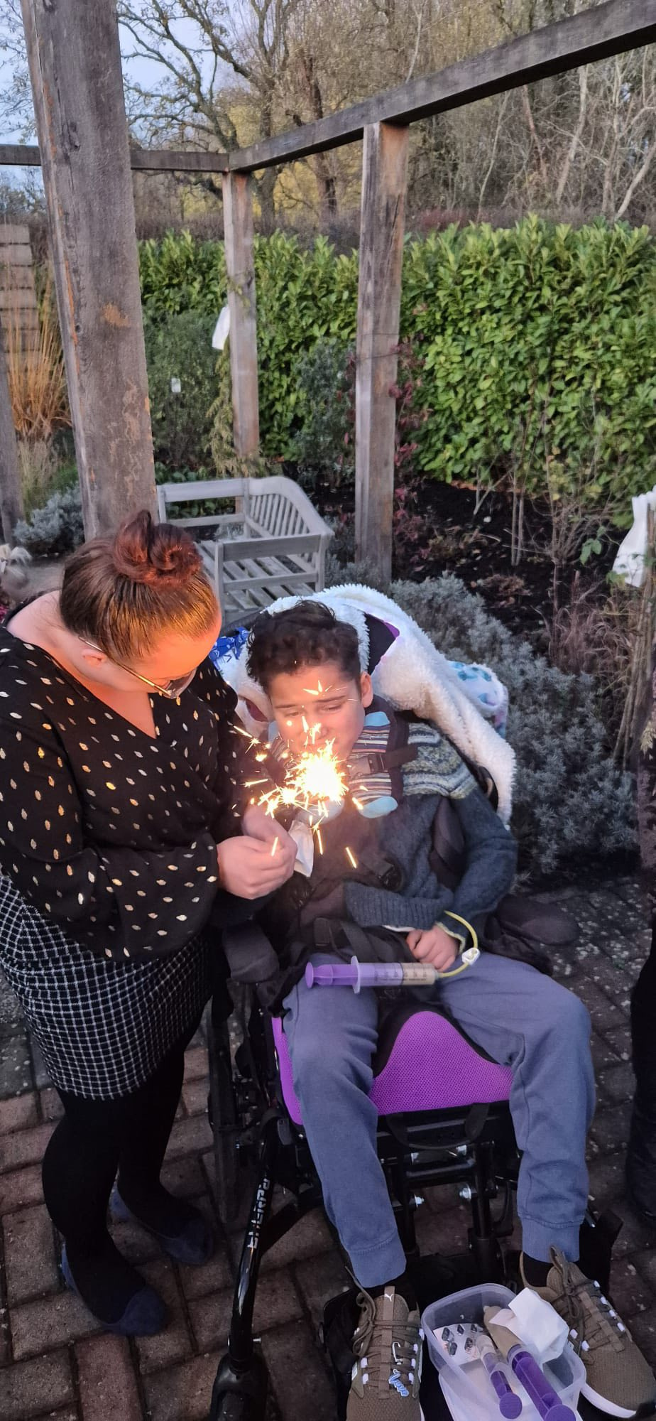
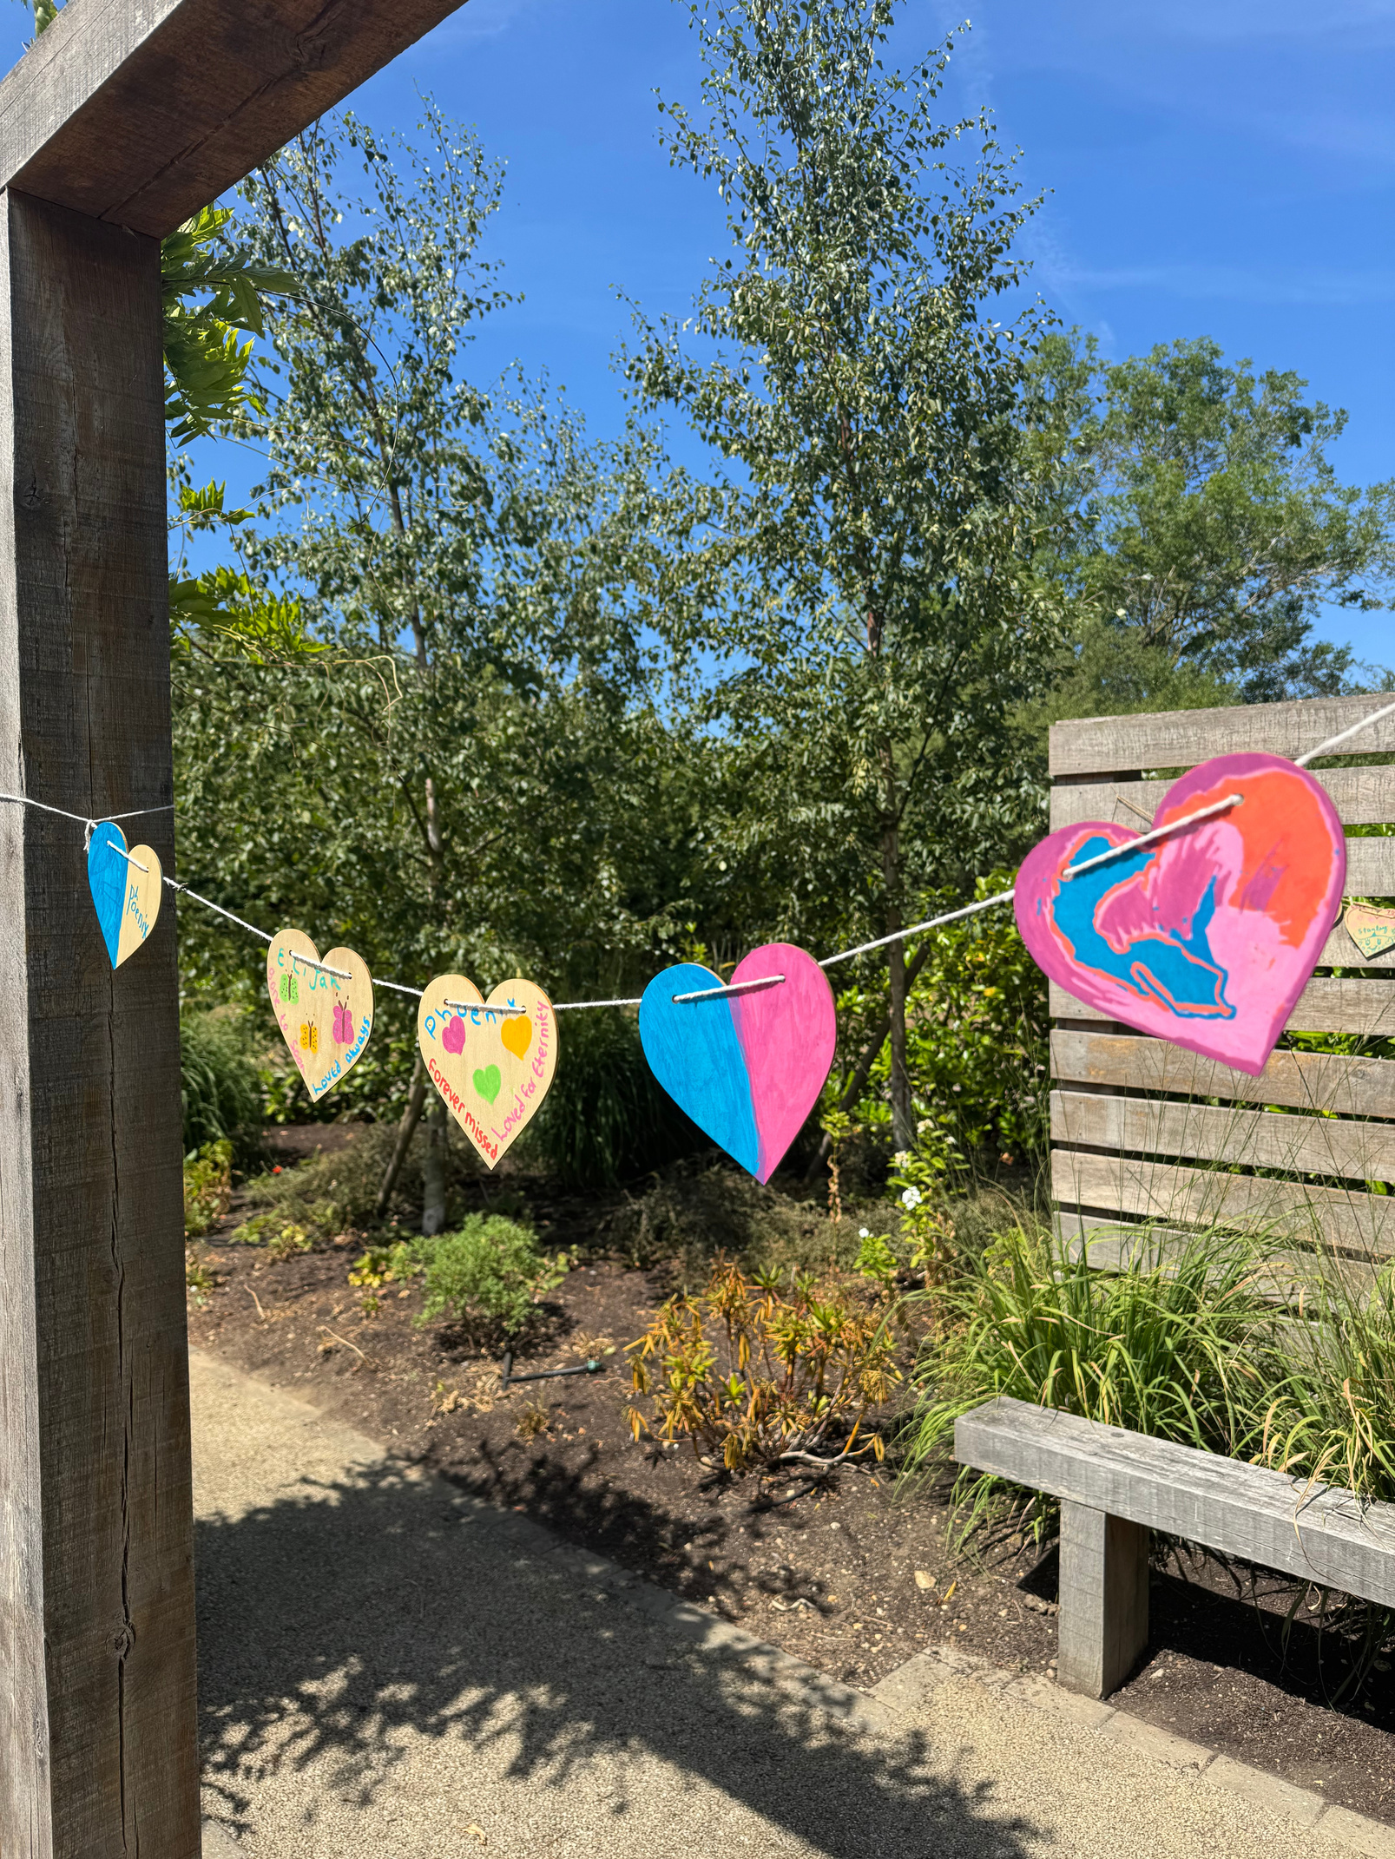
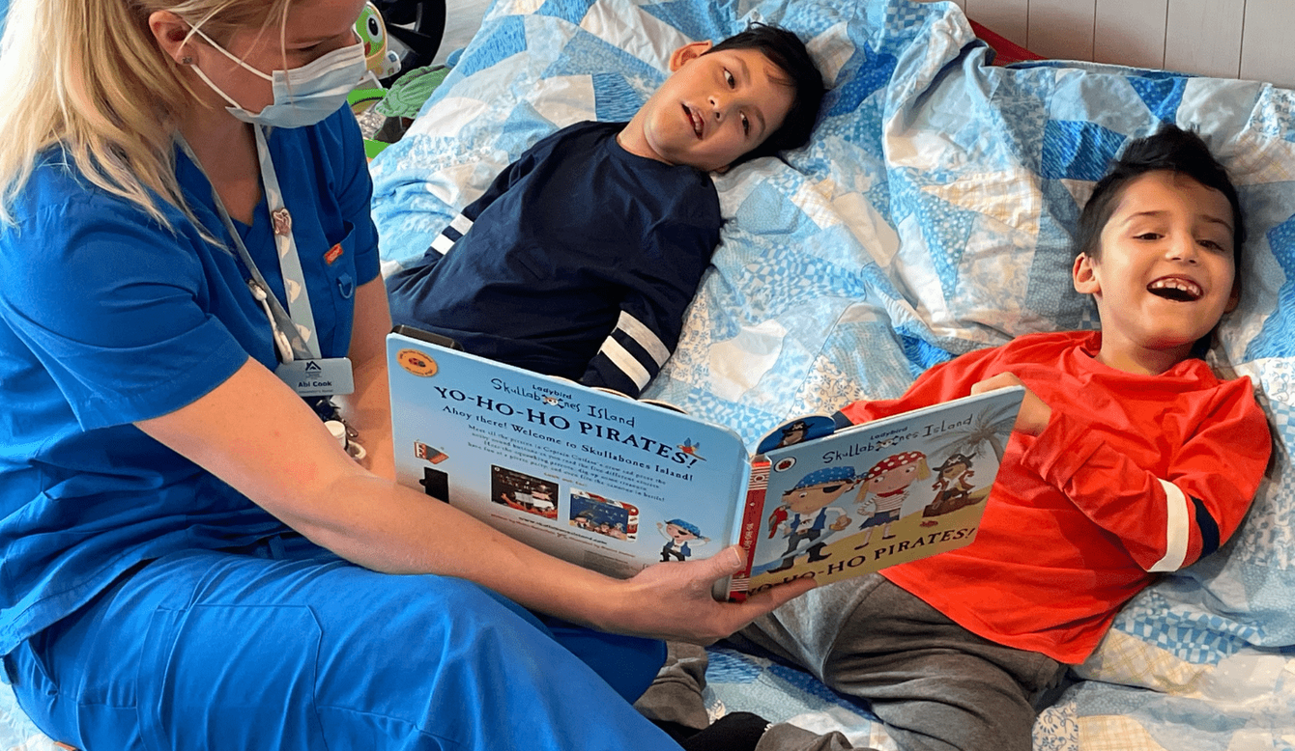
Remembrance Events
Notes:
Riley and his mum, Shailza, now attend annual remembrance events in the summer and winter.
“The remembrance events are not just a time to stop and remember Stanley. They’re an opportunity to be with other families and remember I’m not alone. Together, we will always carry them in our hearts.”

Slide 17
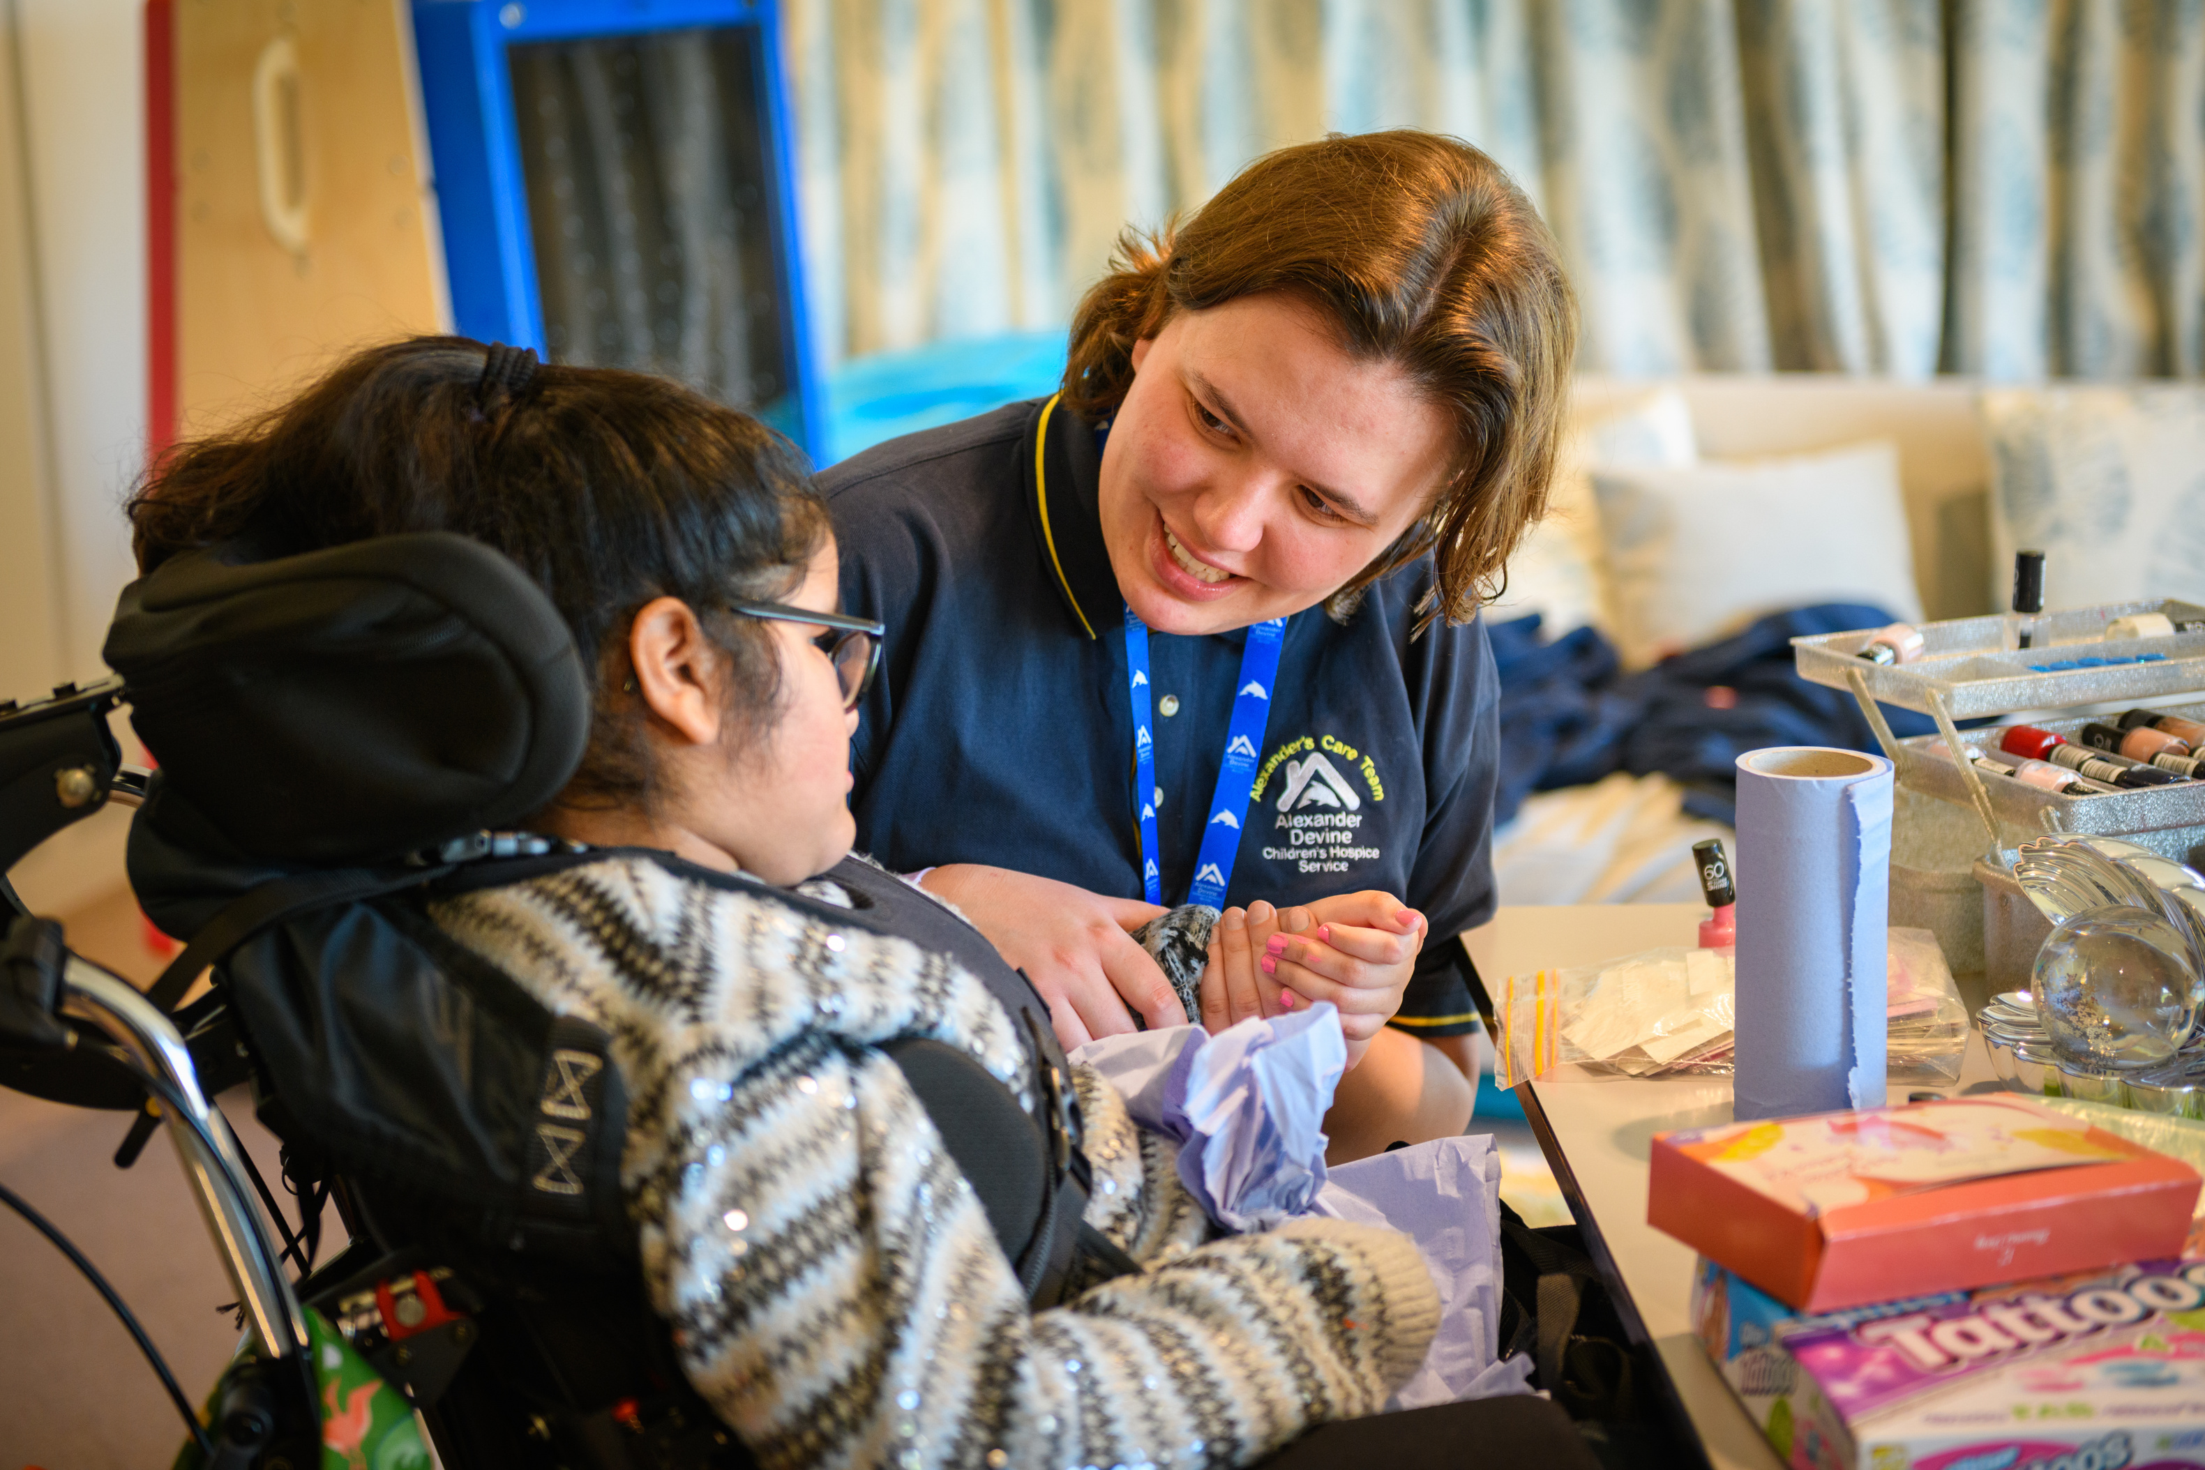

Why Your Support Matters
200+
children and families currently supported by Alexander Devine
1,370+
children in Berkshire alone with
life-limiting conditions and research shows that this number is likely to increase by a further by 2030
11%

Slide 18
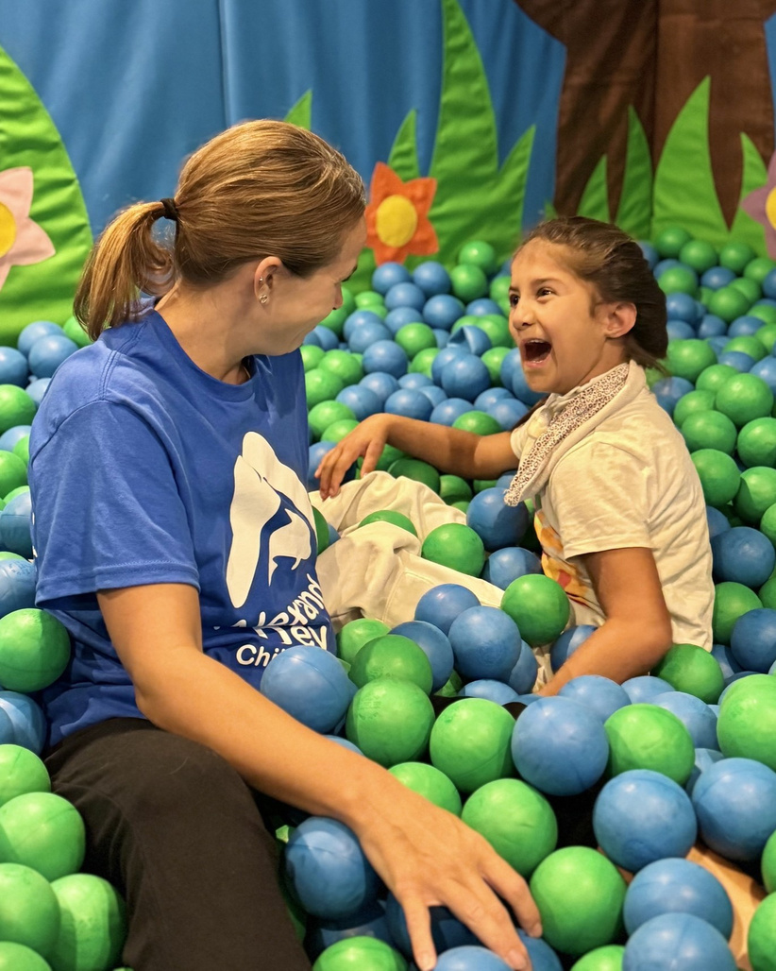
Why Your Support Matters
Only 9 minutes of each hour is covered by funding.
It currently costs £3.4 million per year to run our hospice service.
Only 15% funded by the Government and NHS.

Slide 19

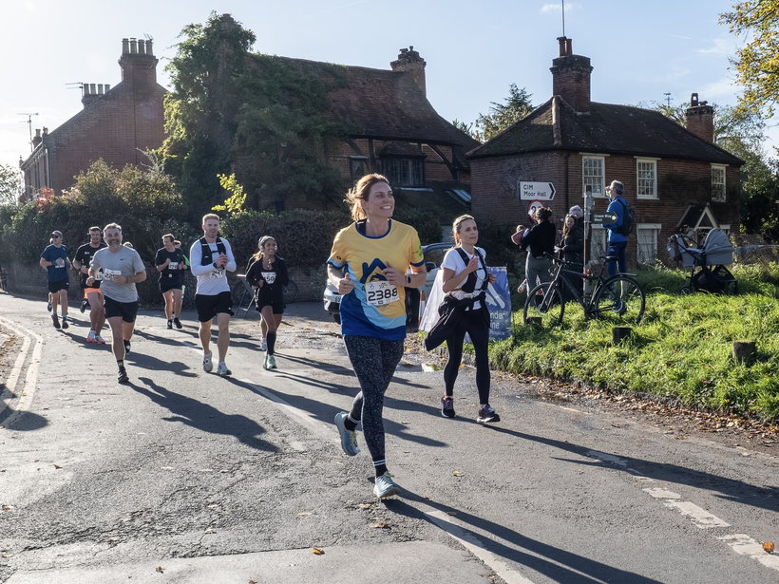
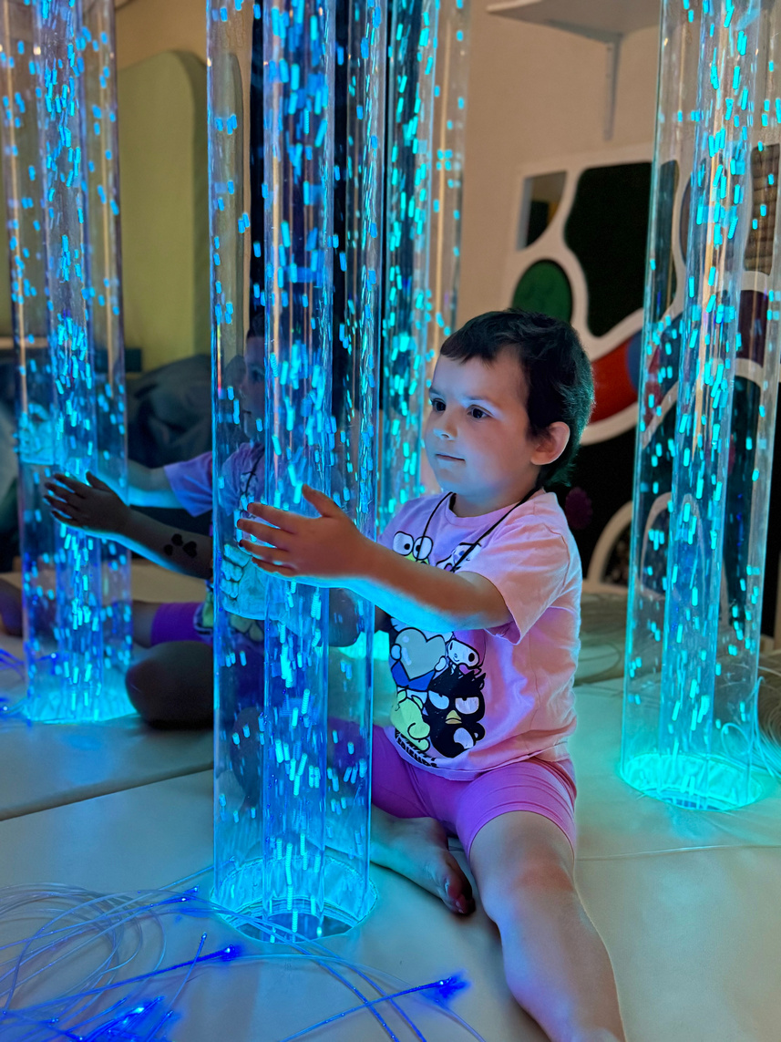
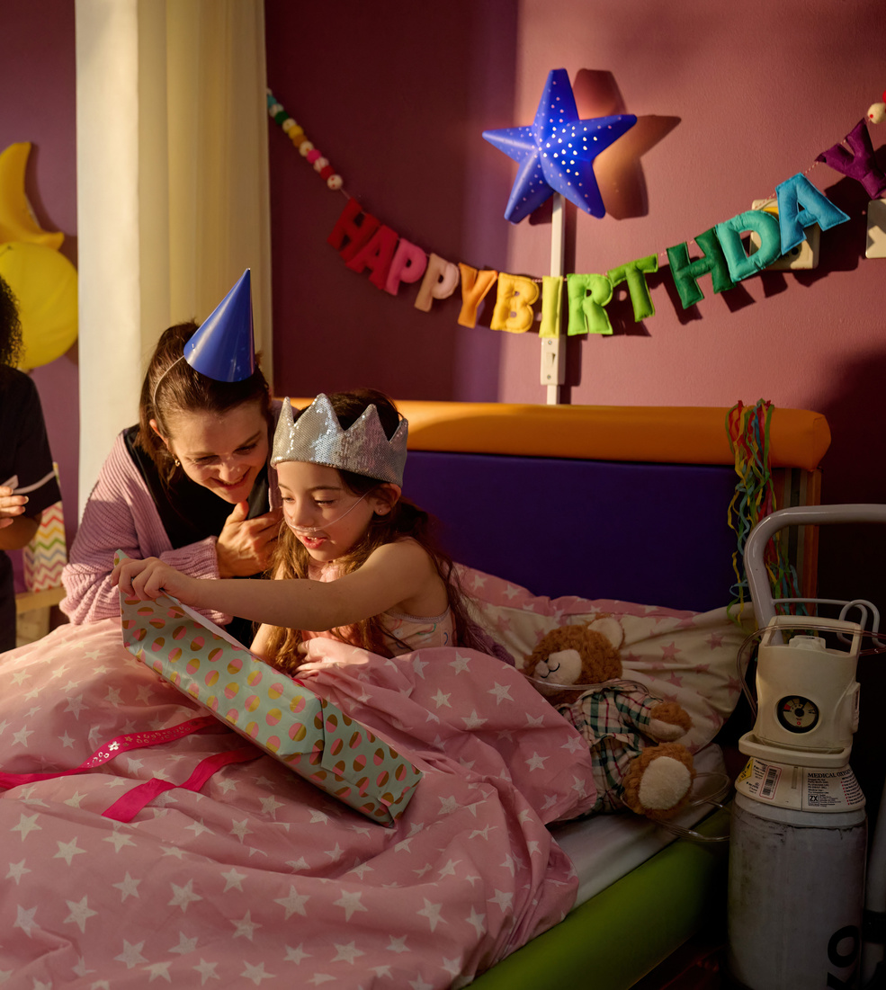
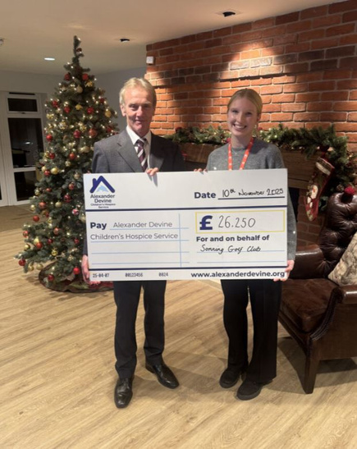
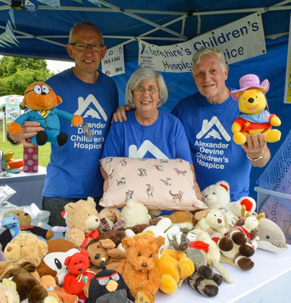
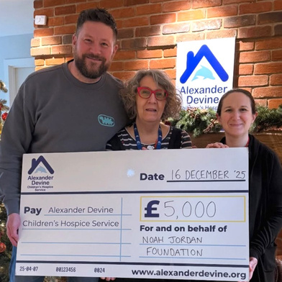
How You Can Help
Attend a hospice event.
Take on a challenge event.
Set up a regular donation.
Join our hospice lottery.
Leave a gift in your will.
Choose us as your charity of the year.
Volunteer with us.
Recommend a Charitable Trust.
Notes:
We run a number of events throughout the year both in the hospice and at wonderful venues. Check out our website or sign up to our regular email newsletter to hear when tickets go on sale for these special events.
We also have lots of opportunities to take on a challenge from UK walks and runs to our Camino de Santiago and Great Wall of China treks in 2027!
Committed, regular support is so valuable to us. If you are able to set up a direct debit to us via our website giving even just £5 a month that would be such a help when we are planning ahead, to know the support we have. Or alternatively play the Local Hospice Lottery in aid of us for just £6 a month.
To help protect hospice care for all, for now, forever please consider leaving a gift in your Will. You can download a Gifts in Wills Guide from our website.
If you have any connections to companies we would be so grateful if you could introduce us.
And finally if you would like to become a volunteer like me and help with fundraising, gardening, knitting, baking, office support or with the Care team please do get in touch.
The options are endless!

Slide 20

Thank you
for your support!
Scan here for more information.
www.alexanderdevine.org

Slide 21
